Slide 1



Slide 2
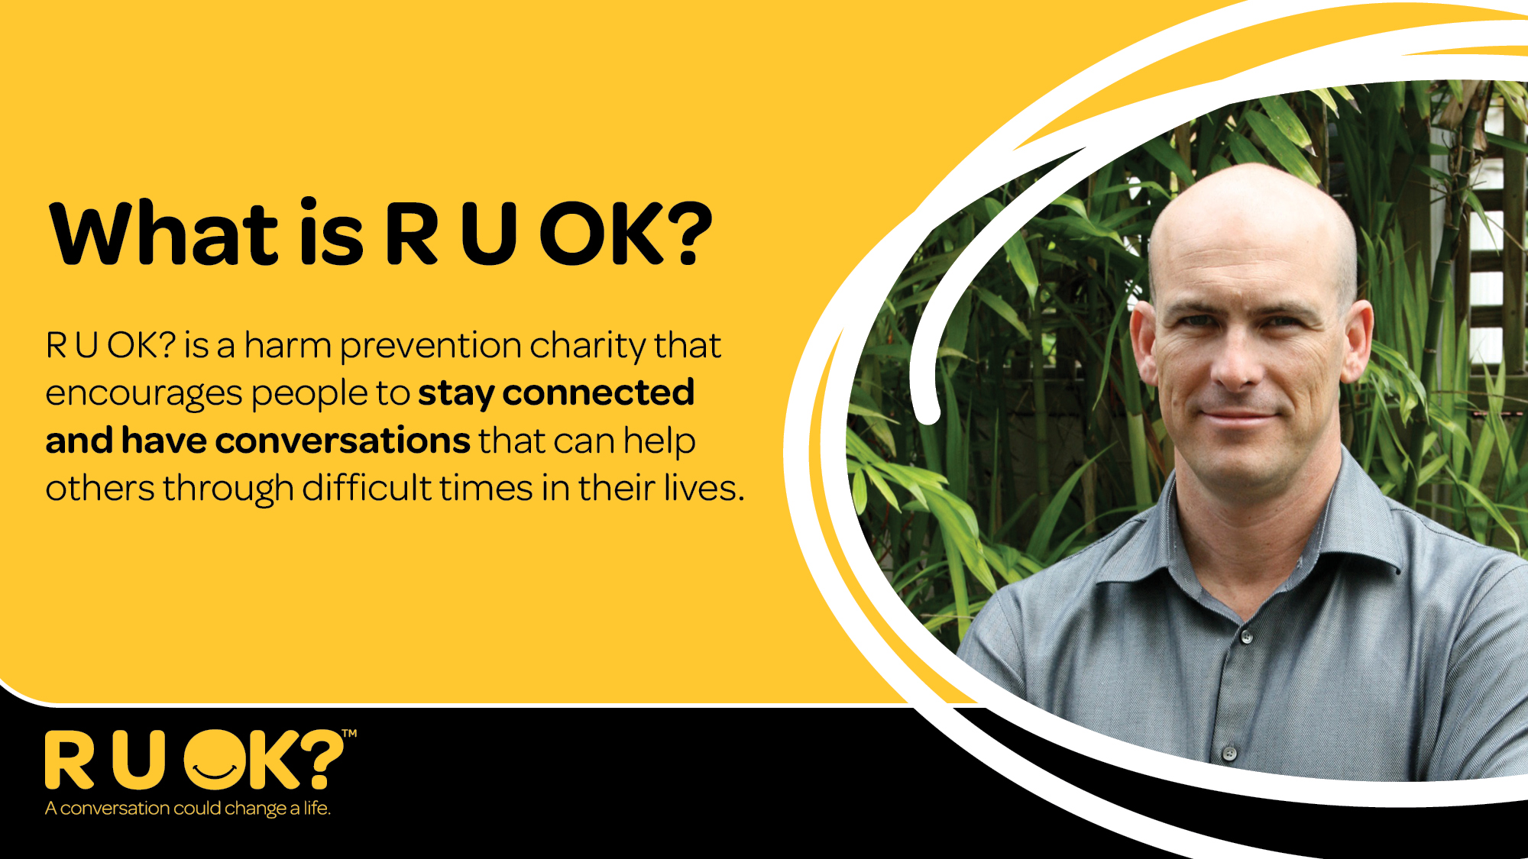
Notes:
What is coming up today?

Slide 3
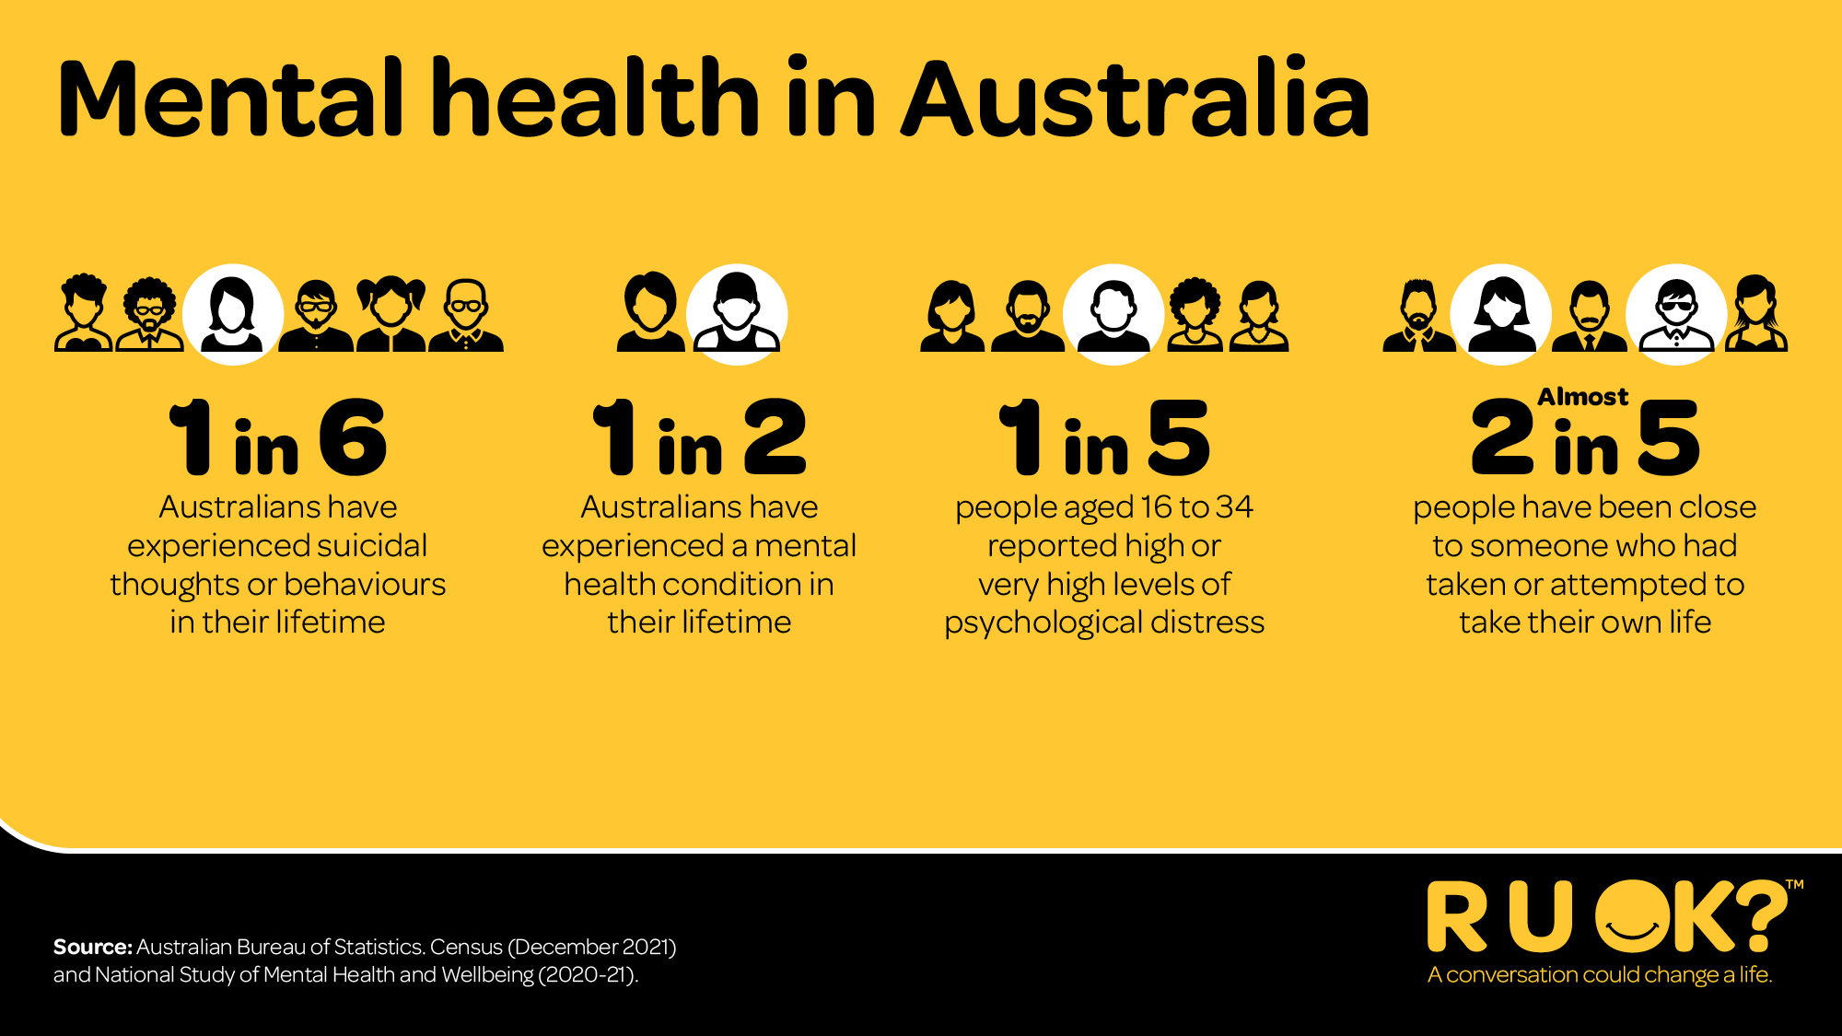
Notes:
Gavin Larkin Story

Slide 4


Notes:
Importance of People not percentages!

Slide 5

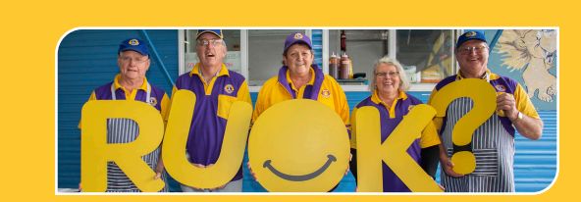

Every day is a great day to share the RUOK? message and hosting an event is a great way to bring people in your team together, start a conversation and make even deeper connections.
We encourage you to organise an event for your team. It might be a morning or afternoon tea, panel or group discussion, team meeting, yellow themed virtual get together, or even a group bush walk over lunch.
Think about how your activity can encourage everyone to ask ‘are you okay?’ whenever they spot the signs that someone they know might be struggling with lift.

Slide 6
Preparing for your event
Educate and inspire: Share stories about how conversations can change lives. Provide tips, resources, and information to help people ask, ‘are you OK?’ and learn what to say if someone says they’re not OK.
Focus on connection: Plan an event or activities that provide opportunity for genuine engagement. Getting to know each other a little better can break down barriers and lead to more meaningful conversations
Connect in: link in with the Healthy University champions on your campus and promote the existing supports that all staff can access at Griffith
Reach out: reach out and chat with the Health & Wellbeing team if you’d like information on how to best support your team surrounding your event. Email them at healthandwellbeing@griffith.edu.au

Slide 7


Slide 8

RUOK Day 2025 - What’s On?
ASKING -RUOK? At Work video -
Anytime, anywhere with CONVERGE International
Flourish Magazine – Focus on RUOK? Day – check out this month’s edition
THRIVE – Where wellbeing converges – focus on Women’s wellbeing. Great articles and information on these channels YouTube or Spotify
Learn more about all the supports and programs you can tap into and engage with to improve your wellbeing by accessing the CONVERGE International App (App code GRIFFUNI)

Slide 9




Griffith’s Health Partners
Click the logo’s below to find more resources and supports for your health and wellbeing

Slide 10






Local Links, Events & Further Support
Click the logo’s above to find more resources and supports for your health and wellbeing, as well as links to local mental health programs and events around Southeast QLD

Slide 11

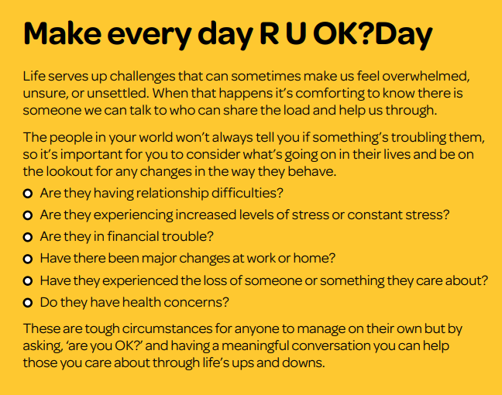


Slide 12
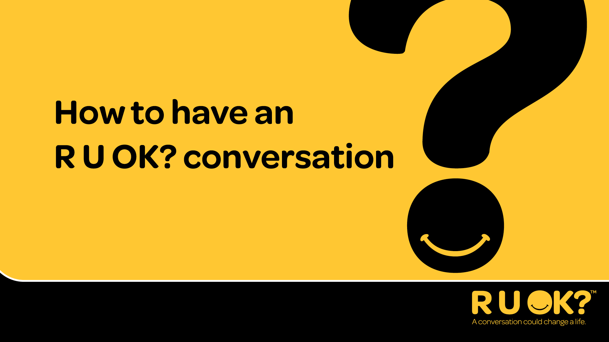

Slide 13


Slide 14
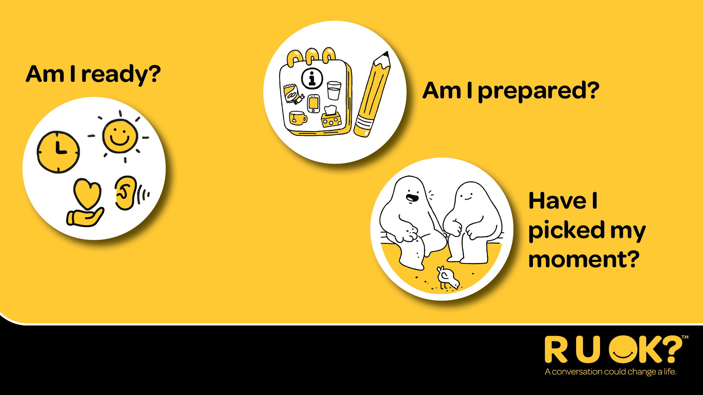


Slide 15
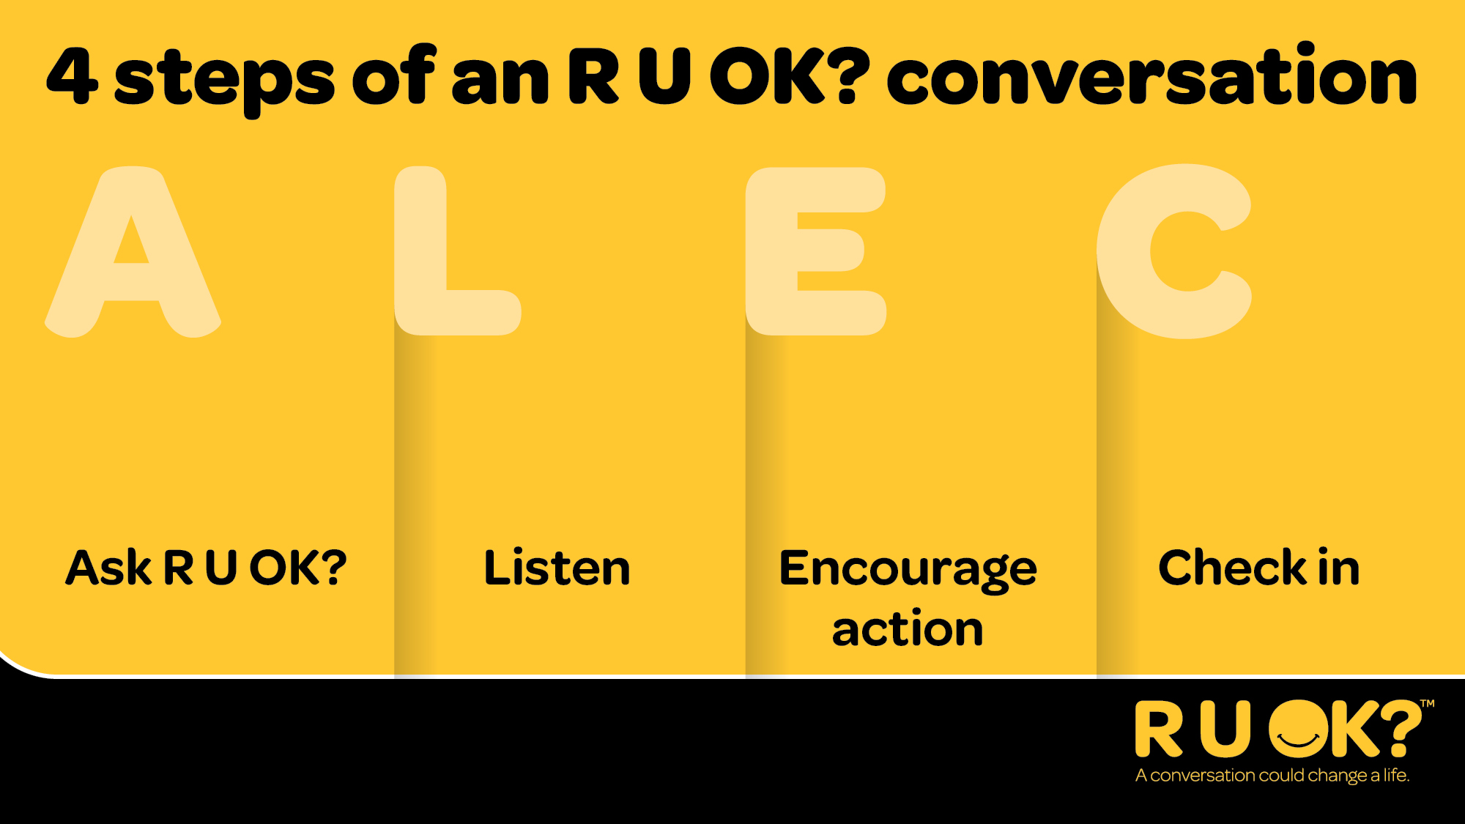
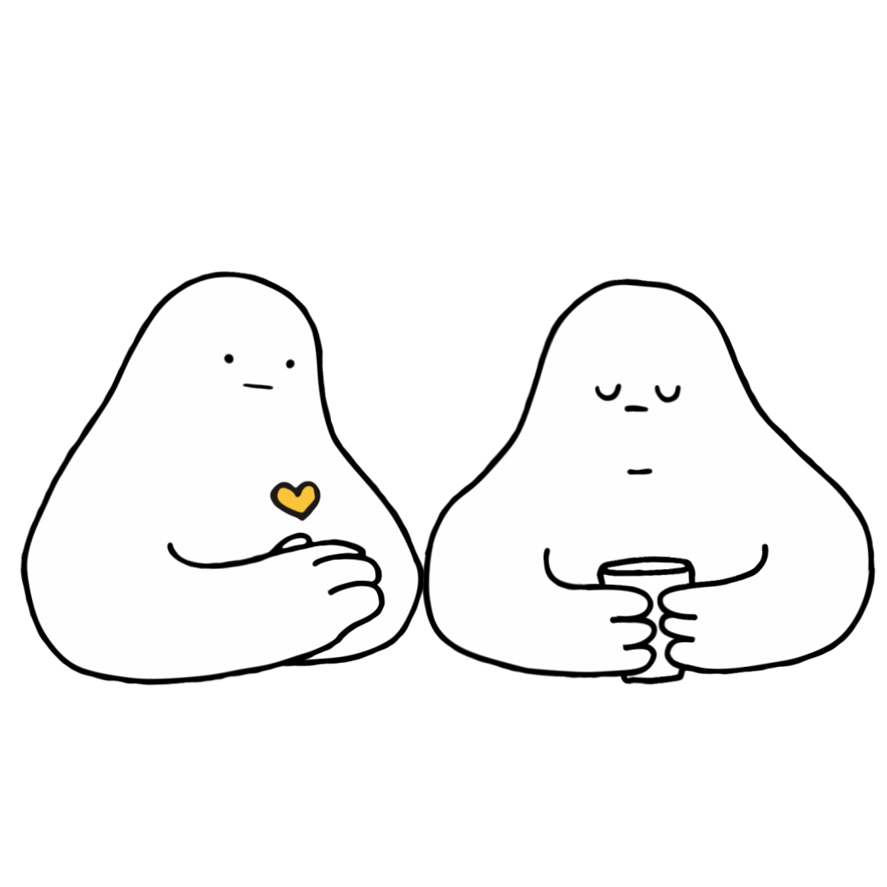
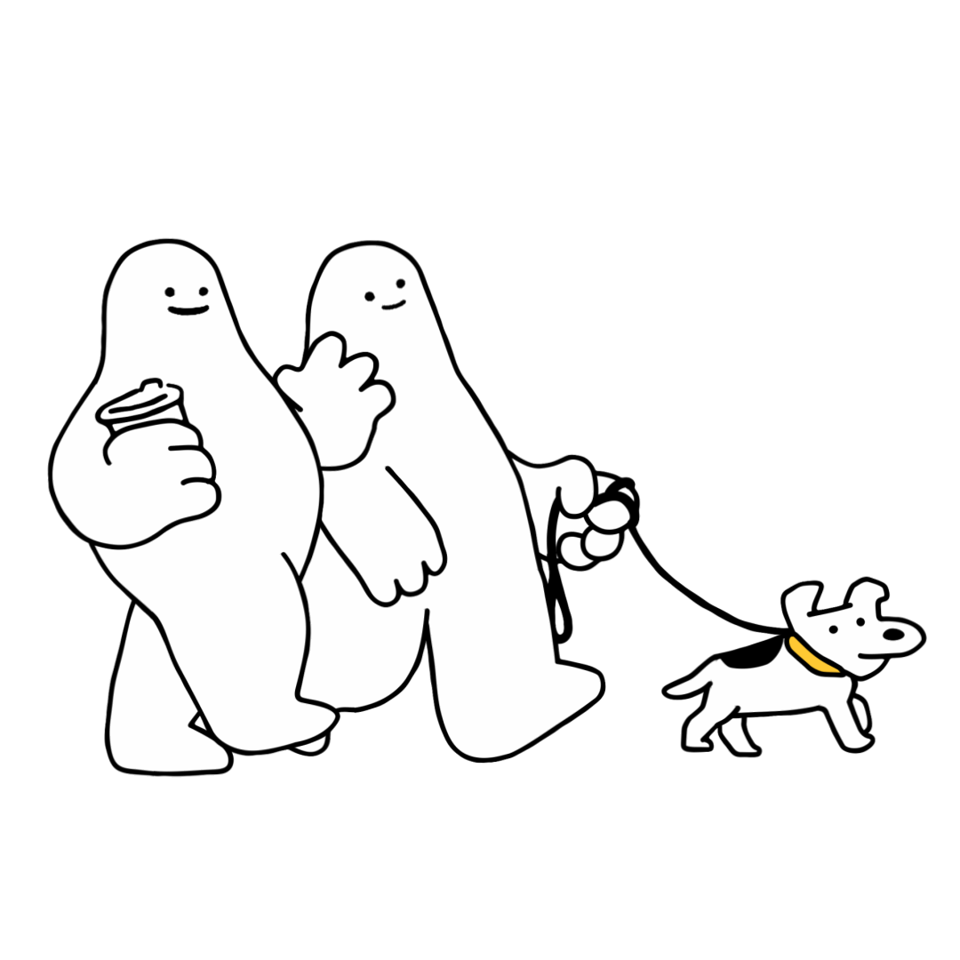
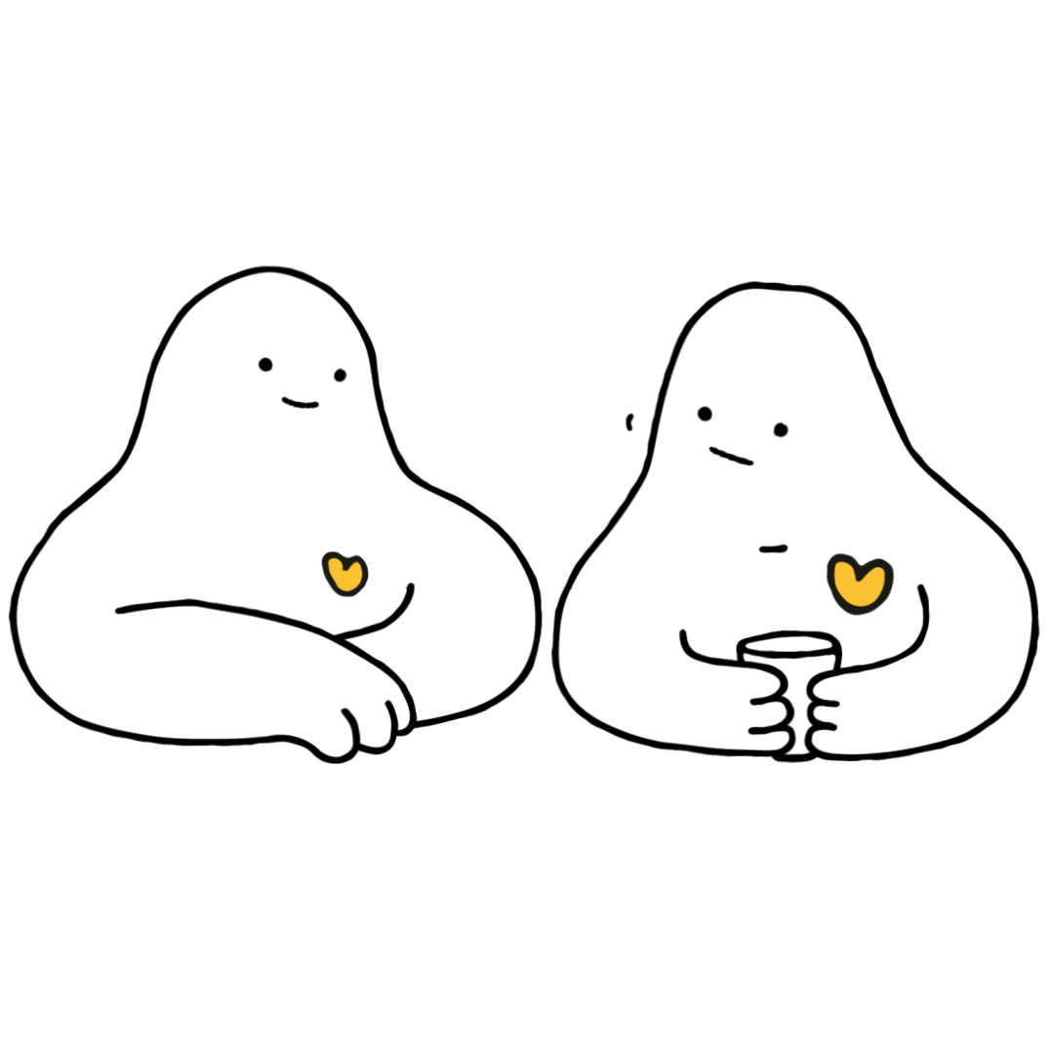
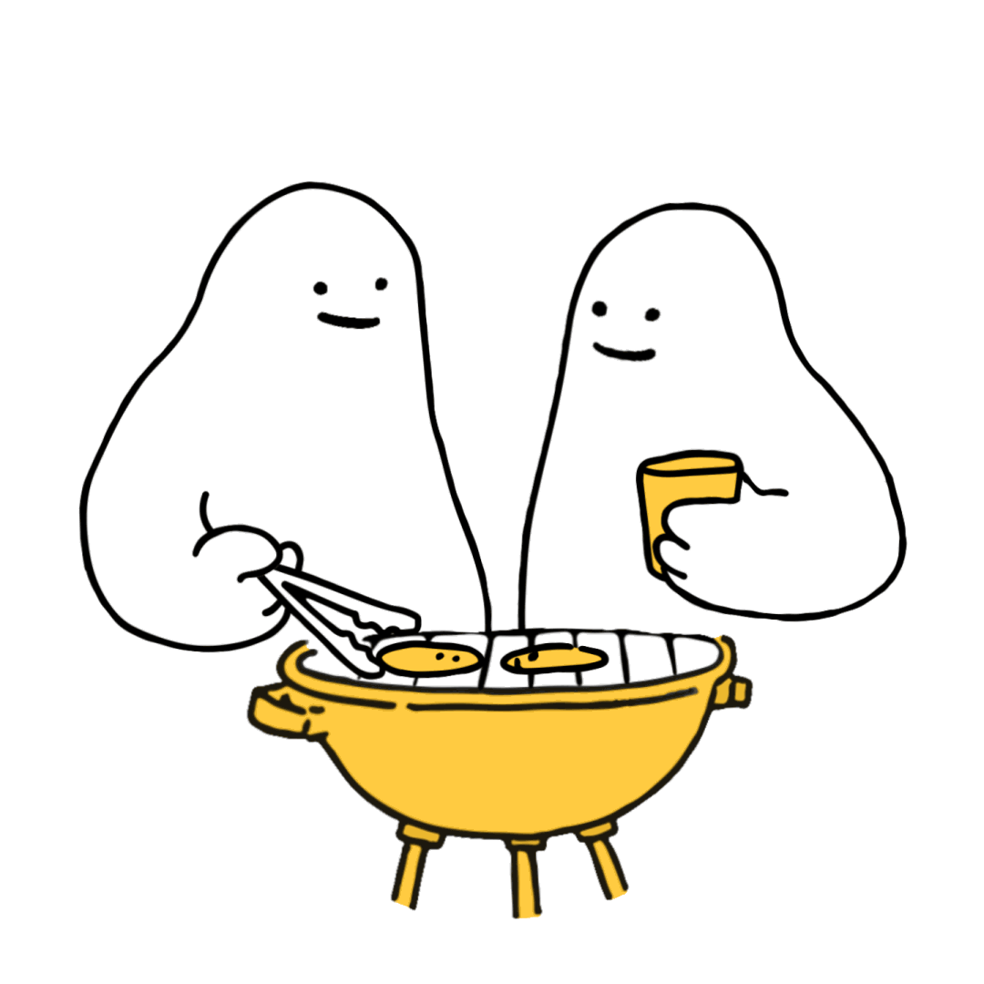

Slide 16
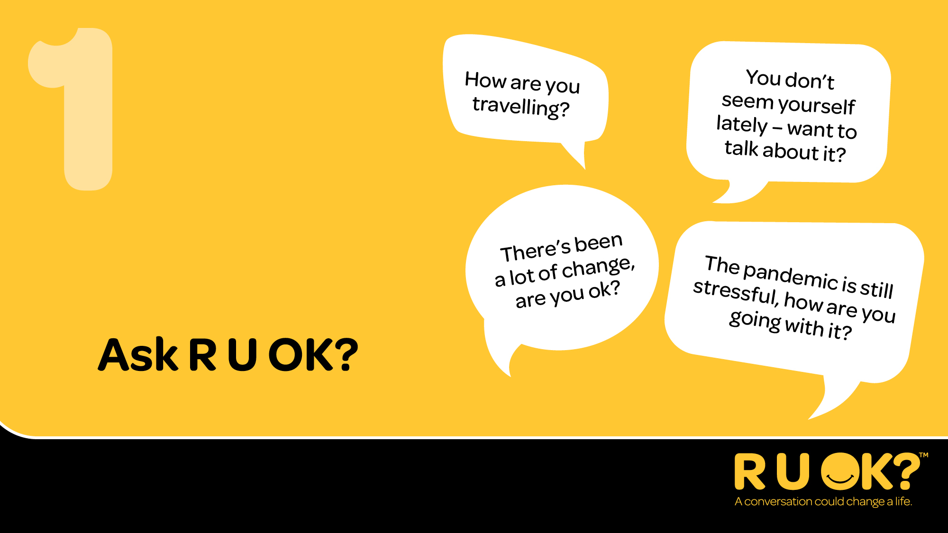

Slide 17
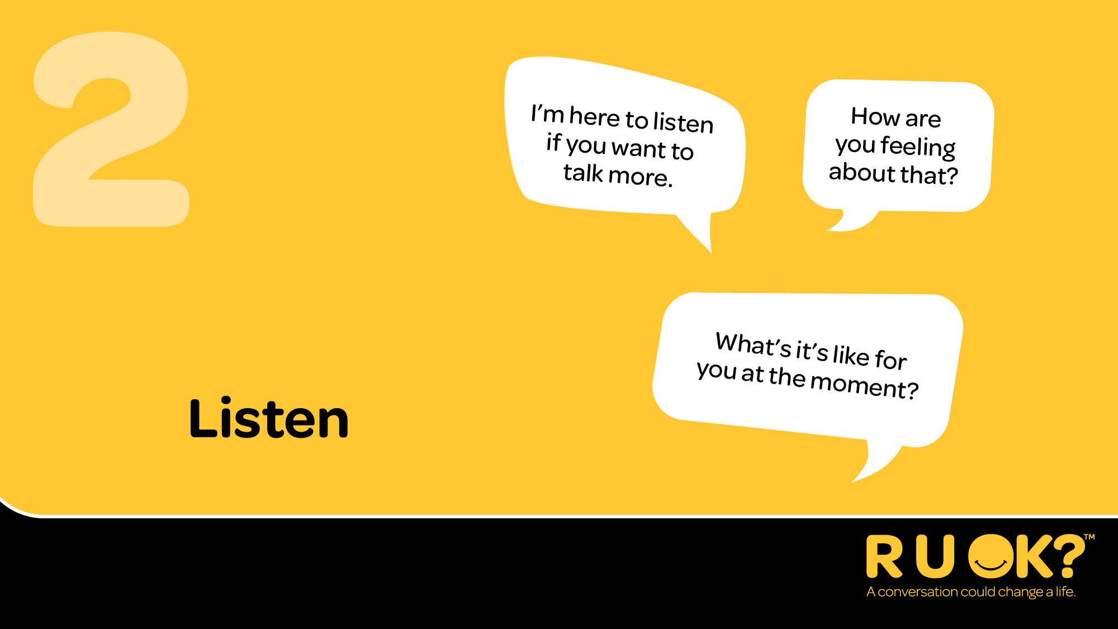

Slide 18
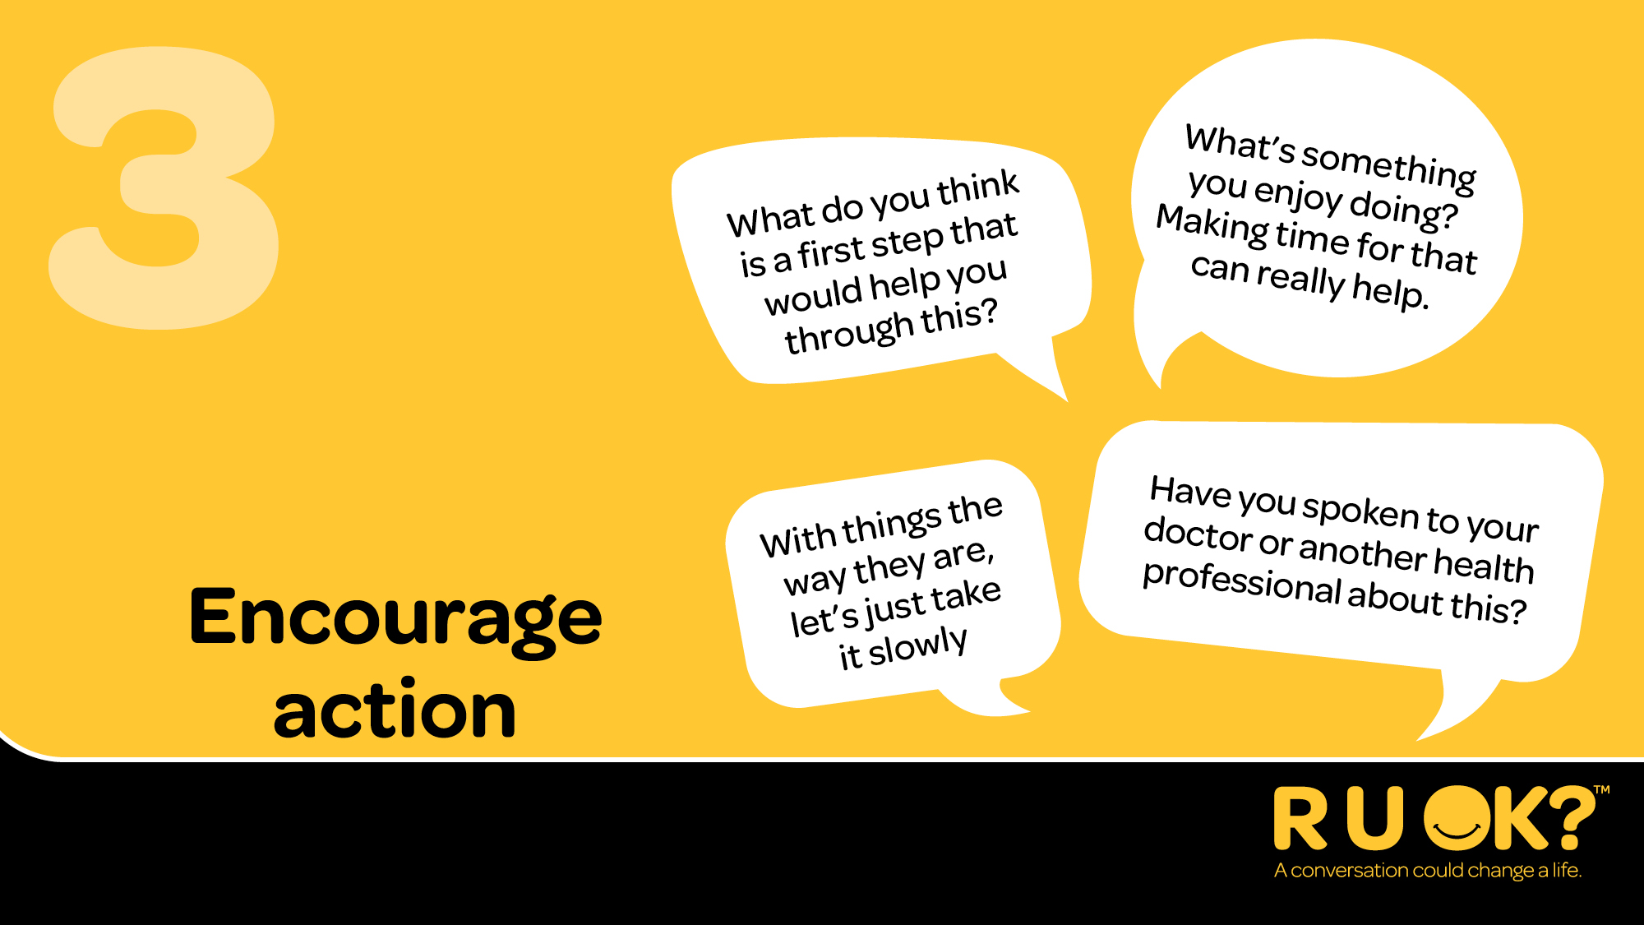

Slide 19
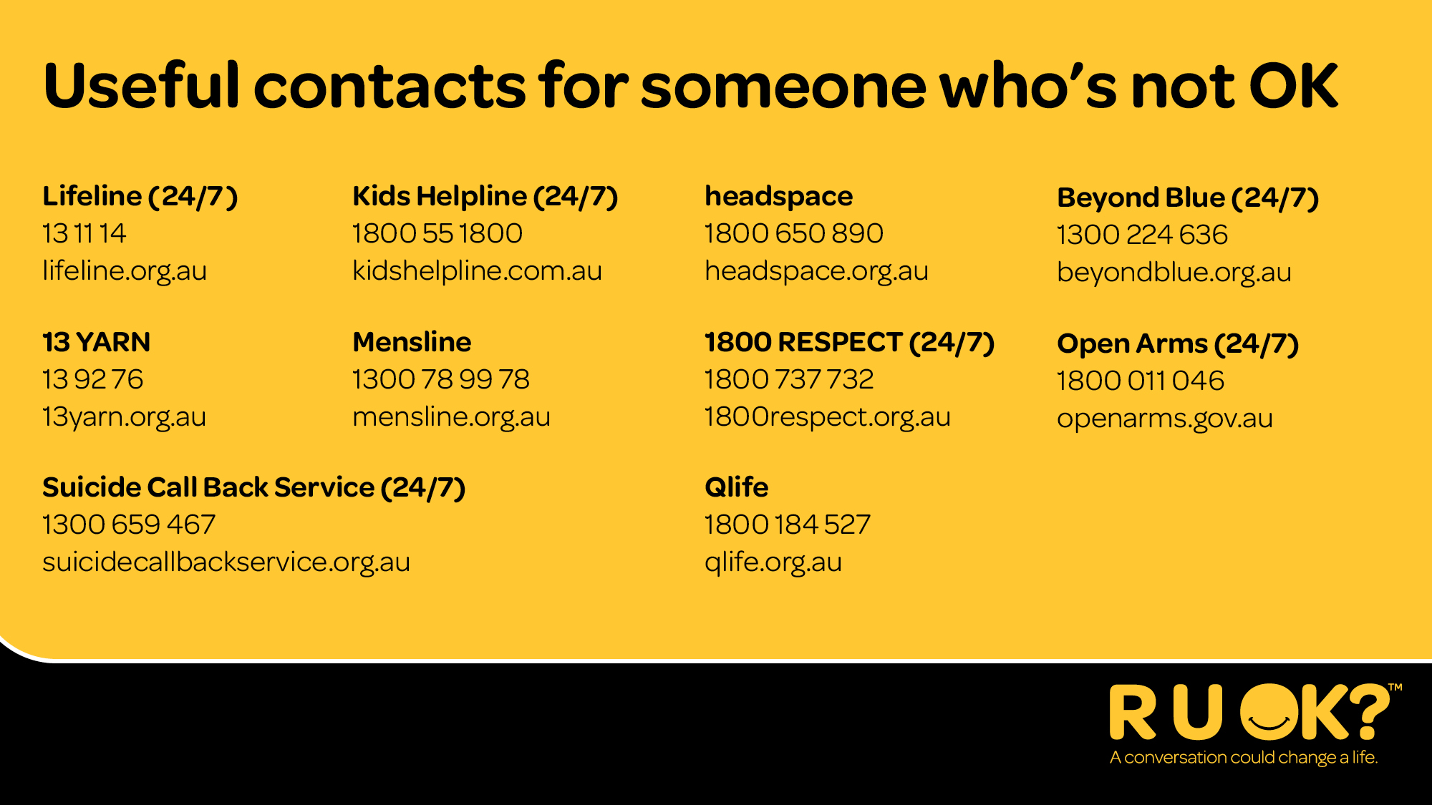

Slide 20
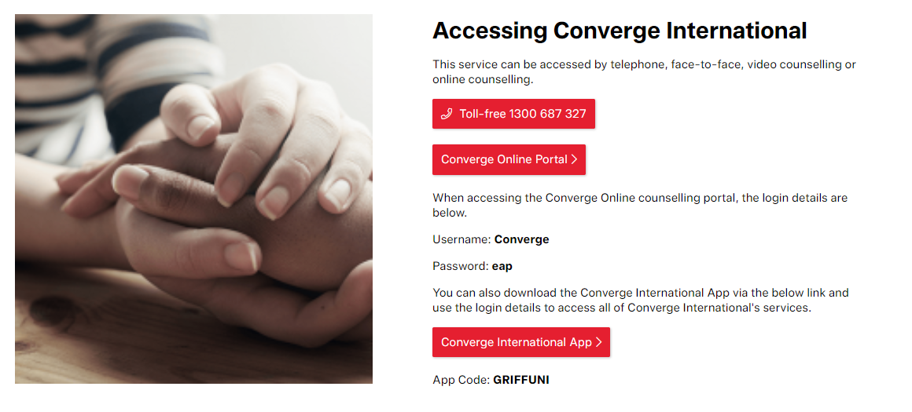
Employee Assistance Program (EAP)

Slide 21
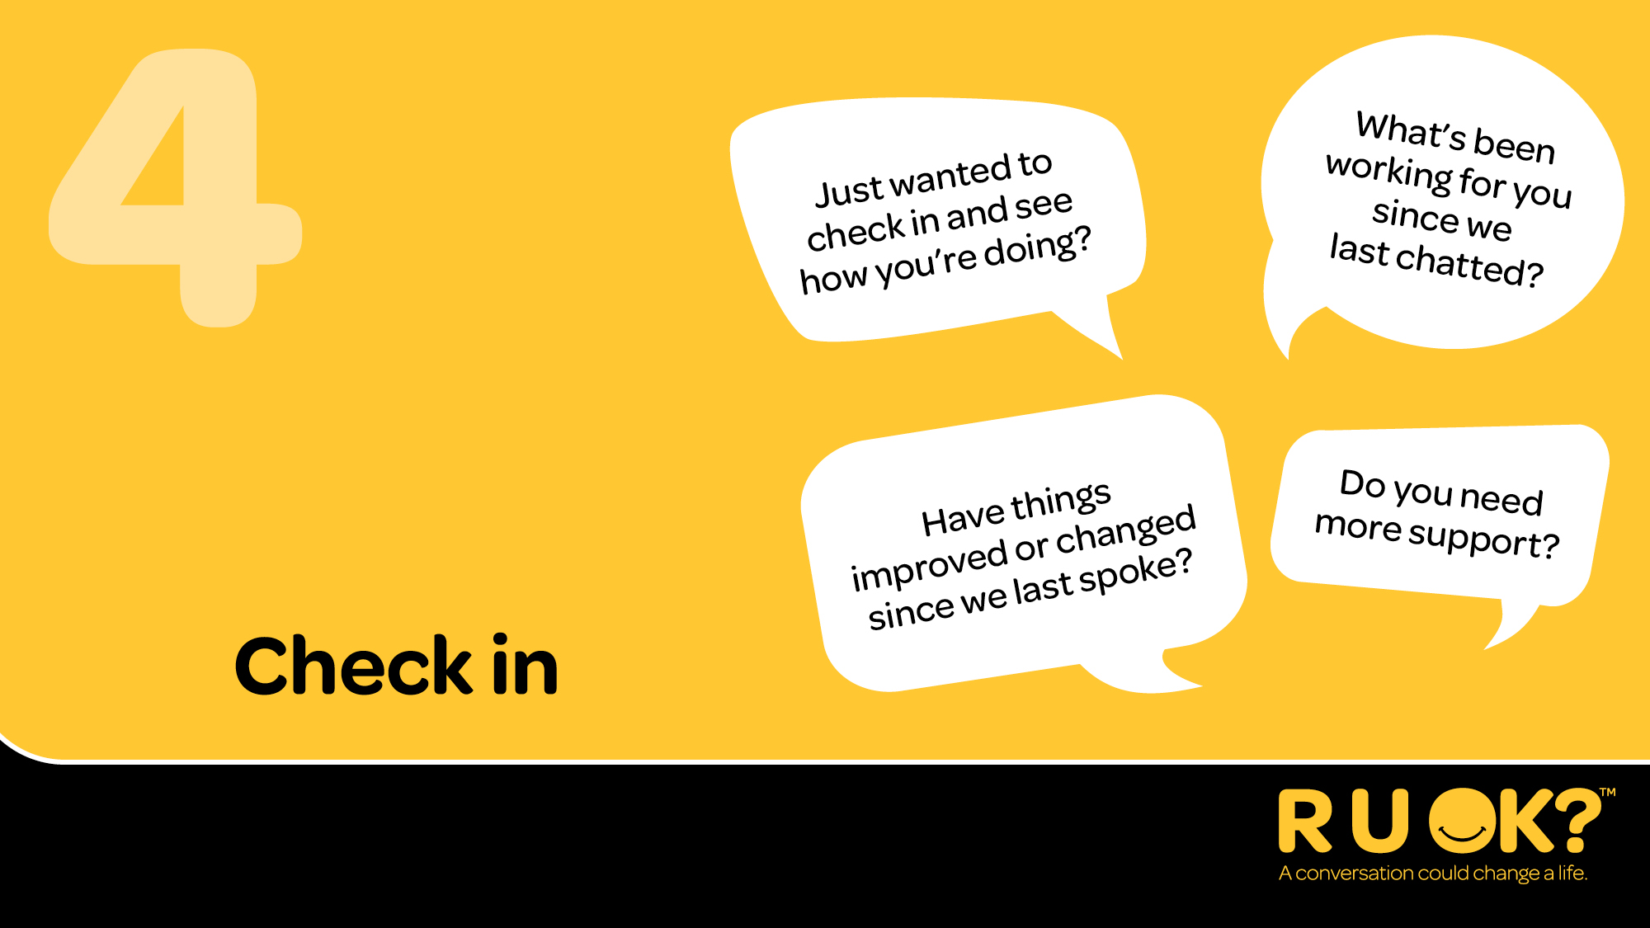

Slide 22


Slide 23


