Slide 1
iLab Reseachers Training
For ADaPT

Slide 2
Agenda
What is iLab?
Key Terms
Preparing to use iLab
Tools and navigation
  Break
Working with ADaPT
Managing your requests
Help & support
Notes:
What is iLab?
Requesting projects and services
Booking and scheduling equipment and people
Manages billing
Key terms (iLab website)
Accounts, Labs and Logins
Key terms
Go to iLab website https://help.ilab.agilent.com/35322-getting-started/261285-key-ilab-terms

Slide 3
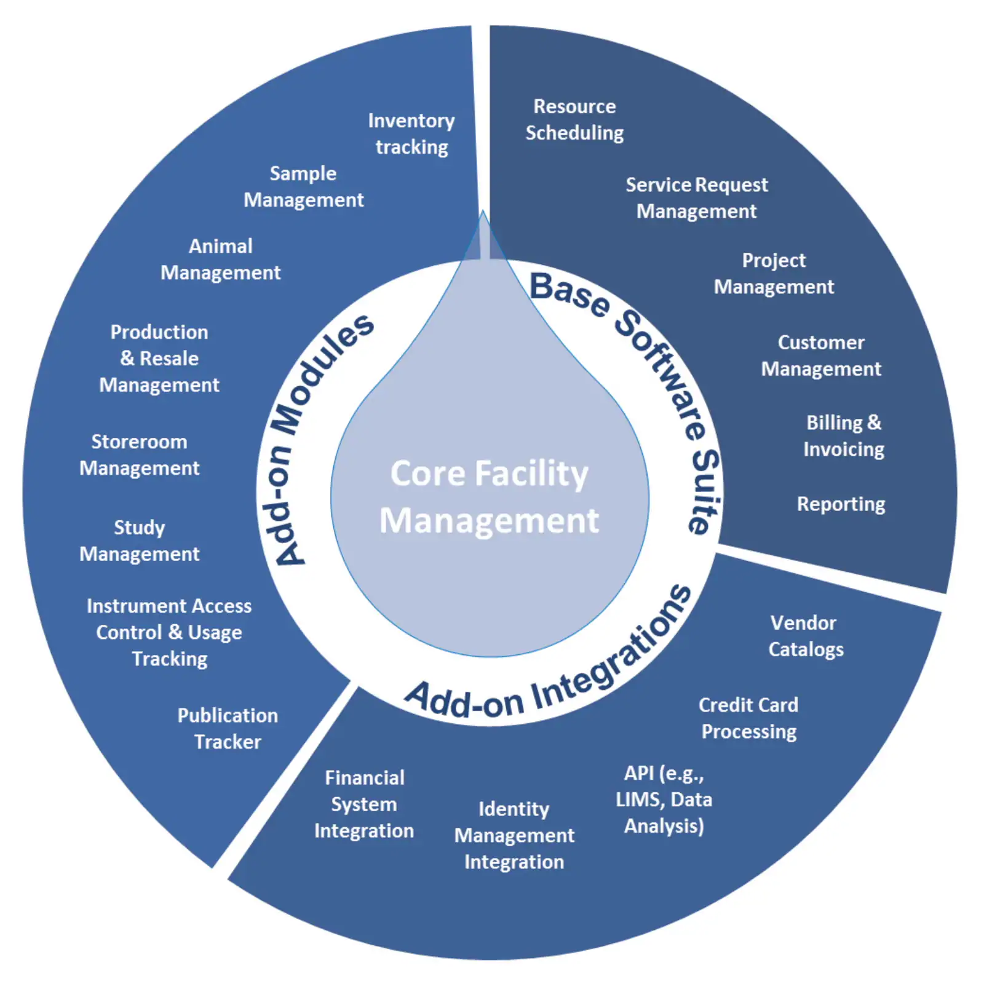
What is iLab?
A tool designed to support labs and shared resource facilities
Uses calendars for booking time with equipment and technical staff
Controls access to sensitive or validated equipment
Manage project requests which track time and billing
Manages on-hand inventory in the facilities

Slide 4
Key terms and concepts

Slide 5

Key terms - entities
Institution: the overall organisation ie Griffith University.
Core Facility: an entity that offers services or access to resources in the university. In iLab, each Facility (Core, for short) has an online store-front that customers can use to identify the offerings available and directly order products/services.
Lab/Group: A group of users, supervised/managed by a Principal Investigator(PI) and/or Lab/Group Managers. In iLab, Labs/Groups are typically used as the primary way to organize access to Funds and manage financial approvals for purchases at Core Facilities.
Centre: A group of labs used to manage subscriptions to ADaPT. If a lab is added to a subscription centre then pricing will be set to zero for all work covered by the subscription.

Slide 6
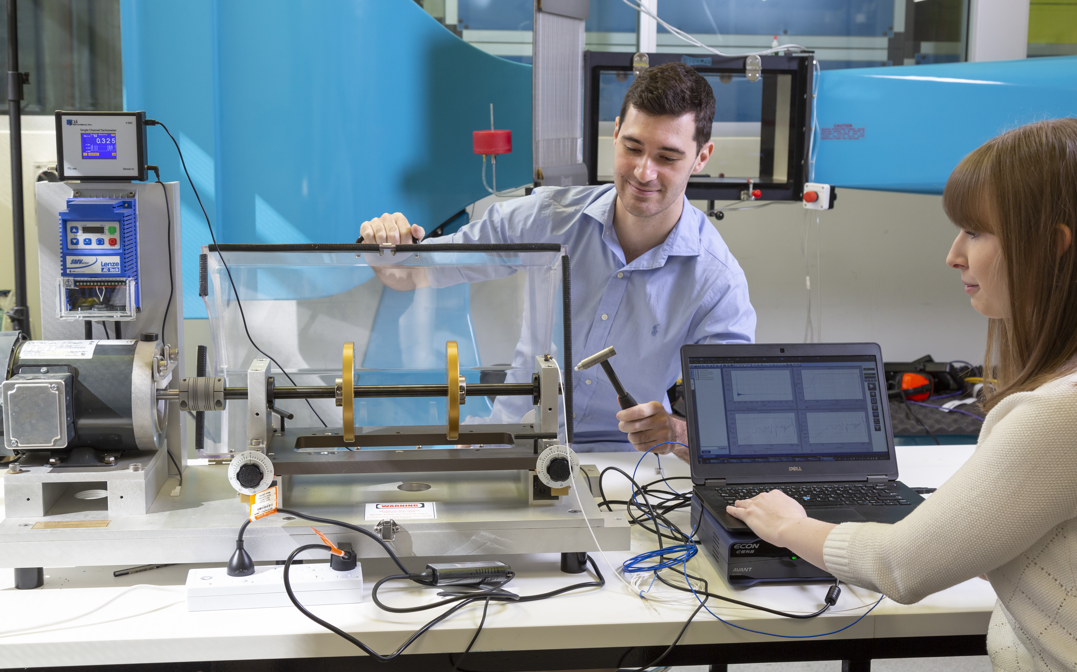
Key terms - users
Institutional Administrator: Dorlene Bradshaw who works in the Office for Research can help with new labs, new accounts and any support issues related to iLab
Principal Investigator (PI): This role is the leader of a lab or group within iLab. Has certain rights to manage users in their lab and control financial access / approvals.
Lab/Group Manager: Administrator of a lab or group with rights similar to the PI.
Lab/Group Member: Any member of a lab or group that does not have any special administrative rights. This is the role that makes requests and bookings.
Core Administrator: Managers of a Facility with administrative permissions.
Core Member: Staff at a Facility without the administrative permissions.

Slide 7

More key terms
Fund: Speed Type & Class used to source funds from when booking services, equipment and staff. In iLab, Funds are allocated to Labs, and from there assigned to individual Lab members by the PI or Lab Managers. When a user orders from a Facility, or looks to make a reservation, they will be able to choose from the Funds made available to them.
Service request: A customer request for a Core Facility to perform various services.
Charge: An individual "line item" that corresponds to a specific product/service provided by a core.
Resource / Equipment: Something that a Core customer can make a (time-based) reservation against. Often represents a piece of equipment, but can also refer to other resources such as specific facility or time with specialists.
Schedule / Calendar: A collection of the bookings for a specific Resource / Equipment.
Reservation: A claim on a specific time slot on a Schedule / Calendar.
Financial Approval: When services are ordered or resources are reserved, typically a financial approval step needs to be completed before the transaction can be completed. The PI designated as a financial contact will need to provide an explicit approval, unless the amount is below a configurable Approval Threshold (in which case the approval is performed automatically).

Slide 8
Preparing to use iLab

Slide 9
Preparing to use iLab
Before using iLab you need to know a few things:
  Do you have an sNumber?
  Do you need a new Lab?
  Do you have at least one speed type and class?

Slide 10
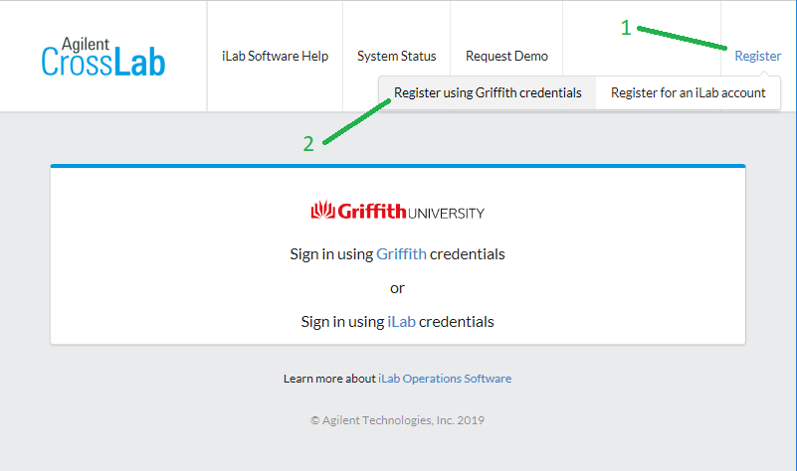
Go to https://griffith.corefacilities.org
Register in iLab exercise

Slide 11
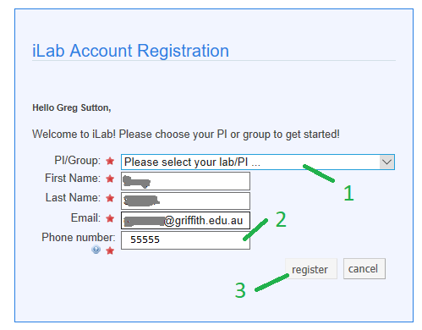
Registration (2)

Slide 12
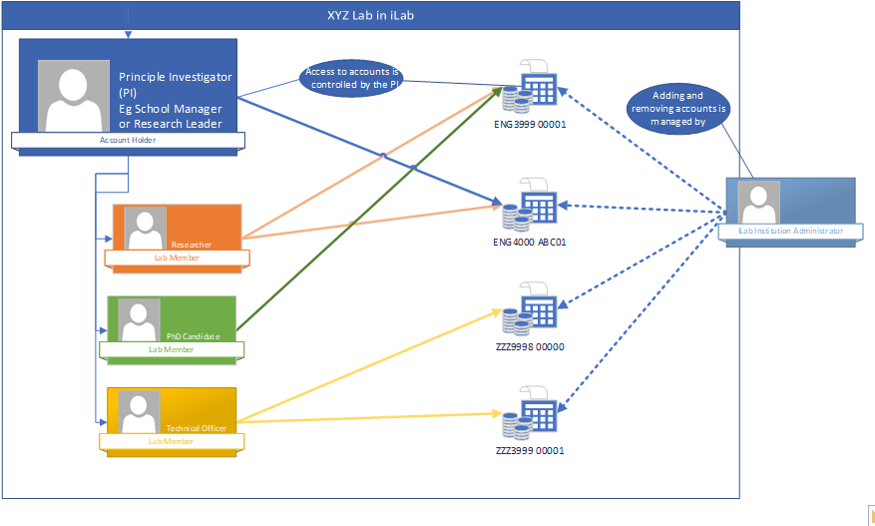
How iLab knows what accounts you can use

Slide 13
Navigation
Finding your way around iLab
A quick run through

Slide 14
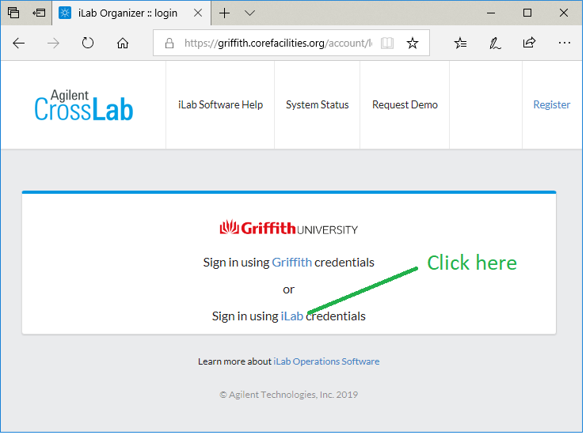
Quick tour
Log in to iLab
Go to https://griffith.corefacilities.org

Slide 15
Quick Tour
Carter Researcher
Log in as Carter Researcher
carter.researcher@ilabx.com
Password: Test1234!

Slide 16
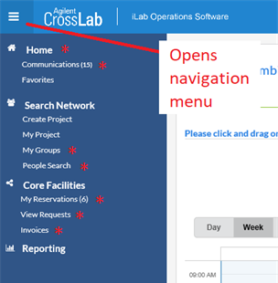
Navigation Hamburger!
Home
  Recent facilities (cores)
  Unread messages
  Service requests with alerts
Communications
My Groups (labs)
My Reservations (bookings)
View Requests (including group members)
Invoices
Notes:
Home:
Recently used cores
Unread messages link
Service Requests (Alerts)
Communications:
Messages that have been sent to you from iLab
My Groups

Slide 17
Time for a break!

Slide 18
Working with ADaPT 1.0
___

Slide 19
Requesting a Subscription

Slide 20
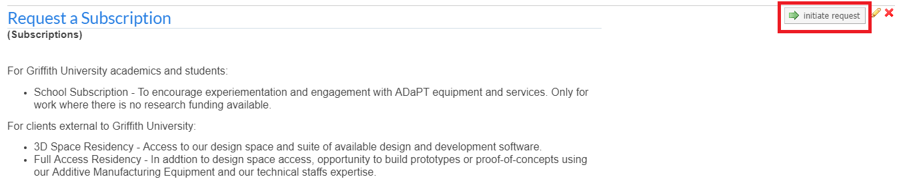
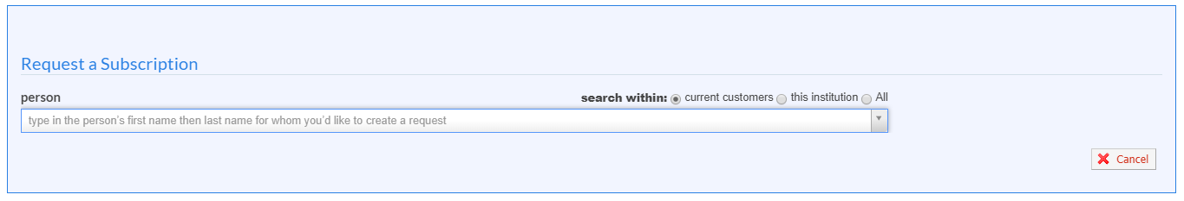
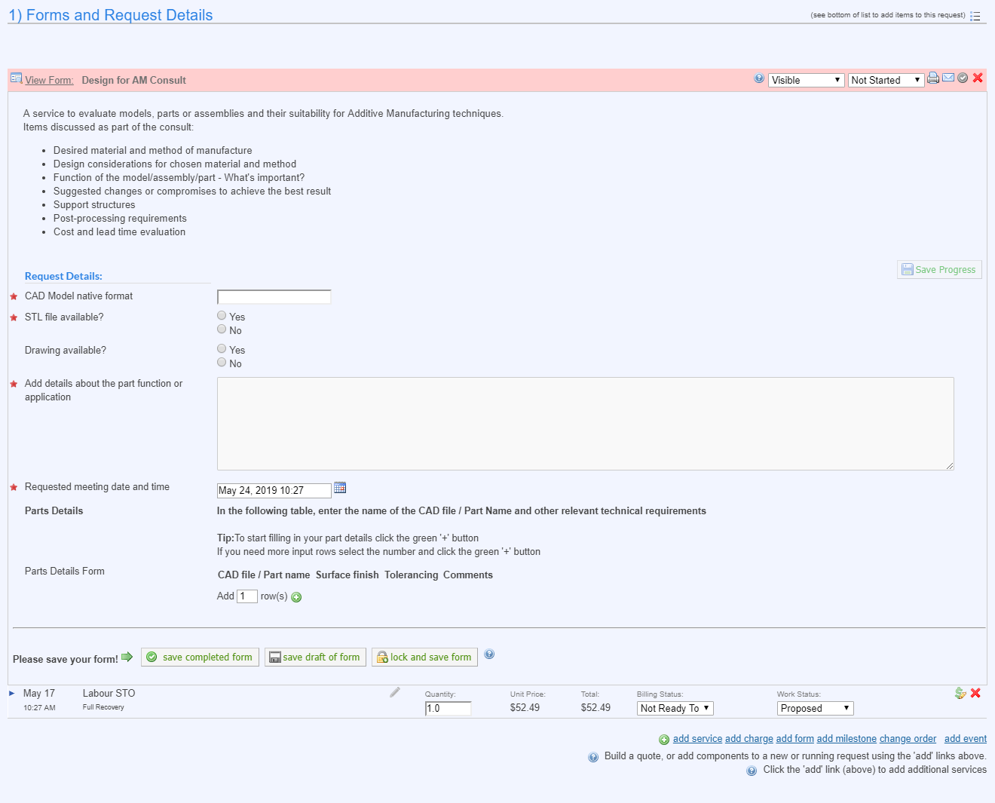
Requesting a Subscription
Navigate to the ADaPT core page and select the Request Services tab.
Identify the Requestor & Lab the request belongs too.
Complete request form ensure all fields are populated with as much information about the request as possible.

Slide 21
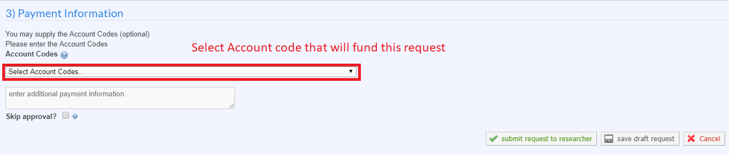
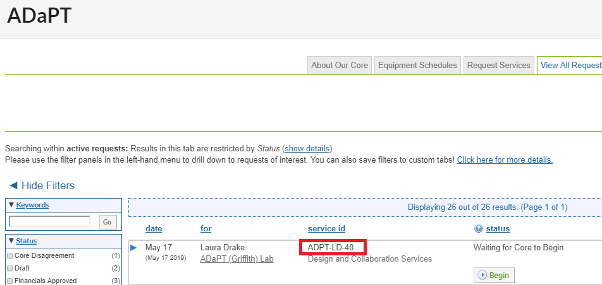
Requesting a Subscription
Complete Payment Information.
Select submit request.
Once submitted a page will appear showing you the service id that you can use to refer to the request from now on.

Slide 22
Requesting
Consultation
Work

Slide 23
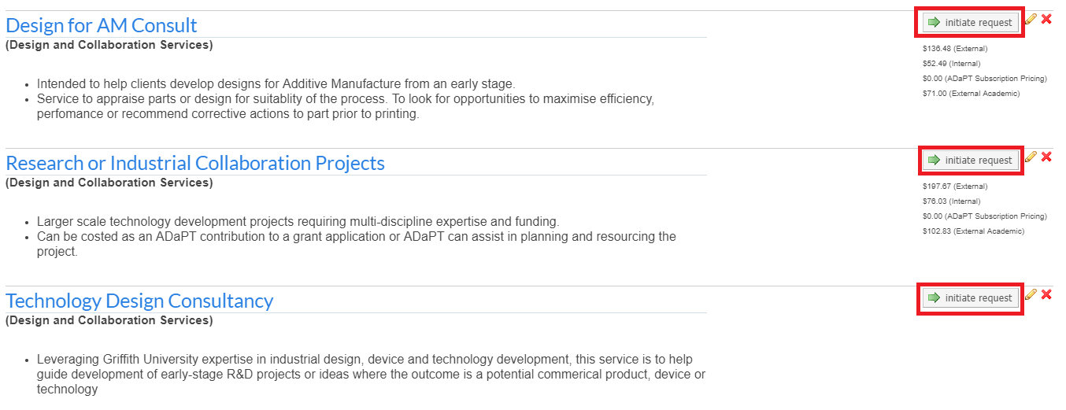
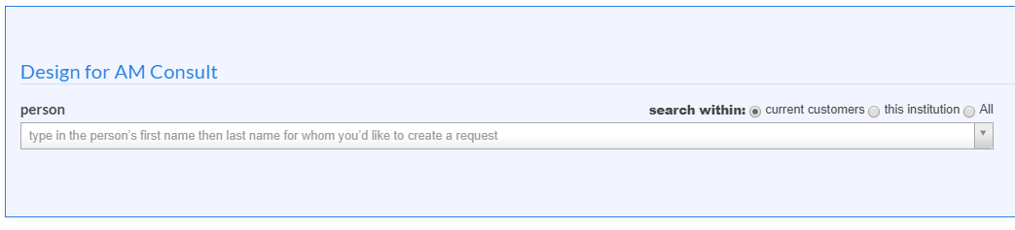
Requesting Consultation work
Select the desired Consultancy type from the request services tab and select “initiate request”.
*Note – Read the descriptions carefully and ensure you complete the correct service request*
Identify the Requestor & Lab the request belongs too.

Slide 24
Requesting Consultation work
Complete request form ensure all fields are populated with as much information about the request as possible.
3D CAD models will be requested at a later date, iLabs does not support CAD file uploads.
*Note – Request forms differ slightly depending on the consultancy type you selected in 1.3.*

Slide 25
Requesting Consultation work
Complete Payment Information
Select submit request.
Once submitted a page will appear showing you the service id that you can use to refer to the request from now on.

Slide 26
Requesting a build
Exercise
1. Go to https://griffith.corefacilities.org
2. Log in as Carter Researcher
  carter.researcher@ilabx.com
  Password: Test1234!
3. Go to https://griffith.corefacilities.org/sc/4497/adapt

Slide 27
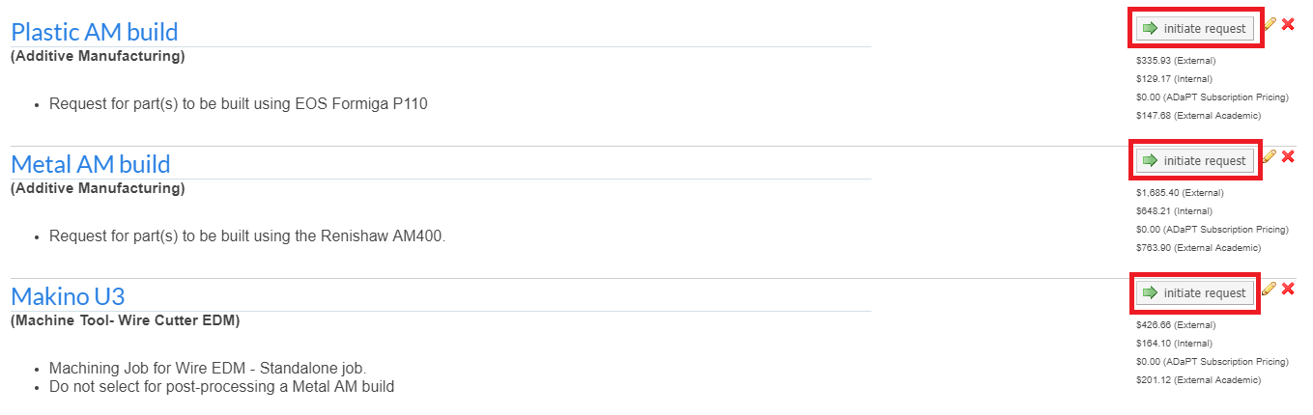
Requesting a Build
Select the desired request from the request services tab and select “initiate request”.
*Note – Read the descriptions carefully and ensure you complete the correct service request*
Identify the Requestor & Lab the request belongs too.

Slide 28
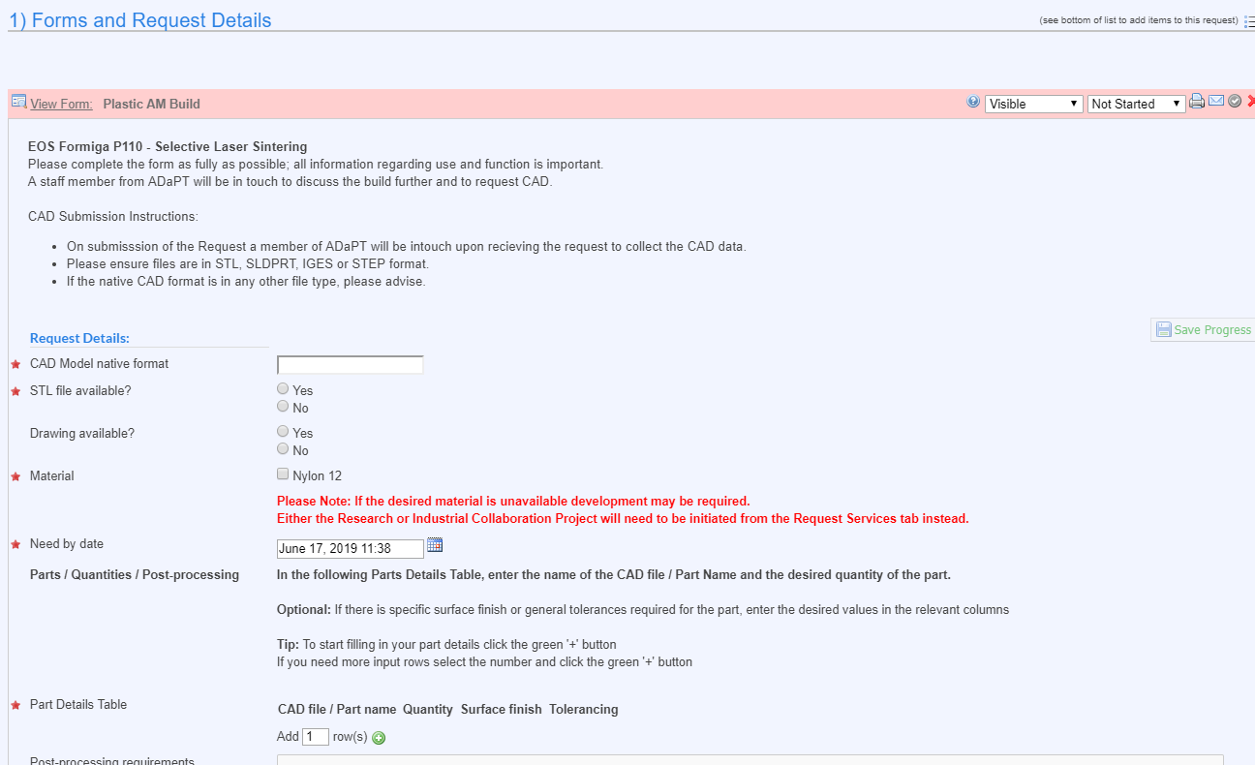
Requesting a Build
Complete request form ensure all fields are populated with as much information about the request as possible.
3D CAD models will be requested at a later date, iLabs does not support CAD file uploads.
*Note – Request forms differ slightly depending on the request type you selected in 1.3.*

Slide 29
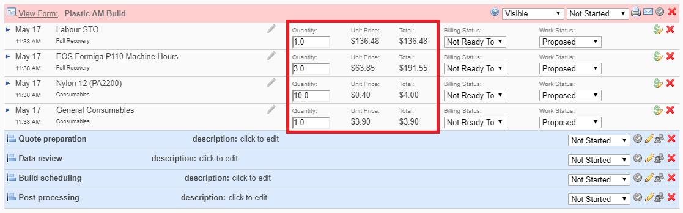
Requesting a Build
Please do not adjust the values in the line items as these are for the core to quote the value of the request.
Complete Payment Information

Slide 30
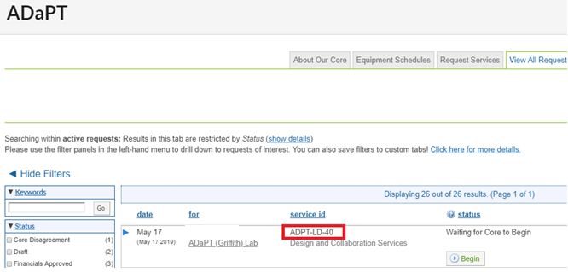

Requesting a Build
Select submit request.
Once submitted a page will appear showing you the service id that you can use to refer to the request from now on.
The Core will review your request and cost up the job. You will be notified when the Quotation is ready to be reviewed.

Slide 31
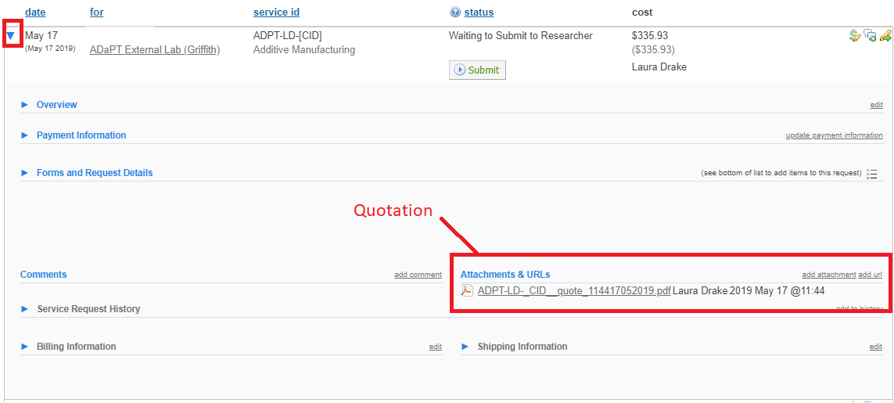
Requesting a Build
To find the quotation expand the request in the list by clicking the small arrow on the left of the row.
Once expanded navigate to attachments and URL’s to find the PDF quotation
Reply to the quotation by selecting “agree” or “disagree” in the status column of the request.

Slide 32
Requesting a Build
Once quotation has been accepted the job will be processed through the ADAPT institute. iLabs will update you with its progress.

Slide 33
Managing your requests
Some tips

Slide 34
A few tips
Job status – see handout
PI’s can view the status of lab member requests using ‘View Requests’
Timeline view
Managing your lab (time permitting)

Slide 35
Help & Support

Slide 36
How to get help & training material
Help
  Visit web iLab web sites for guides, FAQ’s and more
  Ask your facility staff
  Request labs, accounts etc to be created from Dorlene Bradshaw
  Click on the Help button in iLab – Don’t submit tickets.
Training
  Visit iLab web sites
  For PI’s and facility staff - https://help.ilab.agilent.com/51282-webinars/351712-upcoming-webinars

