Slide 1
iLab Training for GRIDD
For all Researchers, Chief Investigators and other lab owners
Version 2.0

Slide 2
Agenda
Introduction
Preparing to use iLab
Break
Using the GRIDD Core
Managing your requests and bookings
Help & support
Research Leader – PI Training
Notes:
What is iLab?
Requesting projects and services
Booking and scheduling equipment and people
Manages billing
Key terms (iLab website)
Accounts, Labs and Logins
Key terms
Go to iLab website https://help.ilab.agilent.com/35322-getting-started/261285-key-ilab-terms

Slide 3
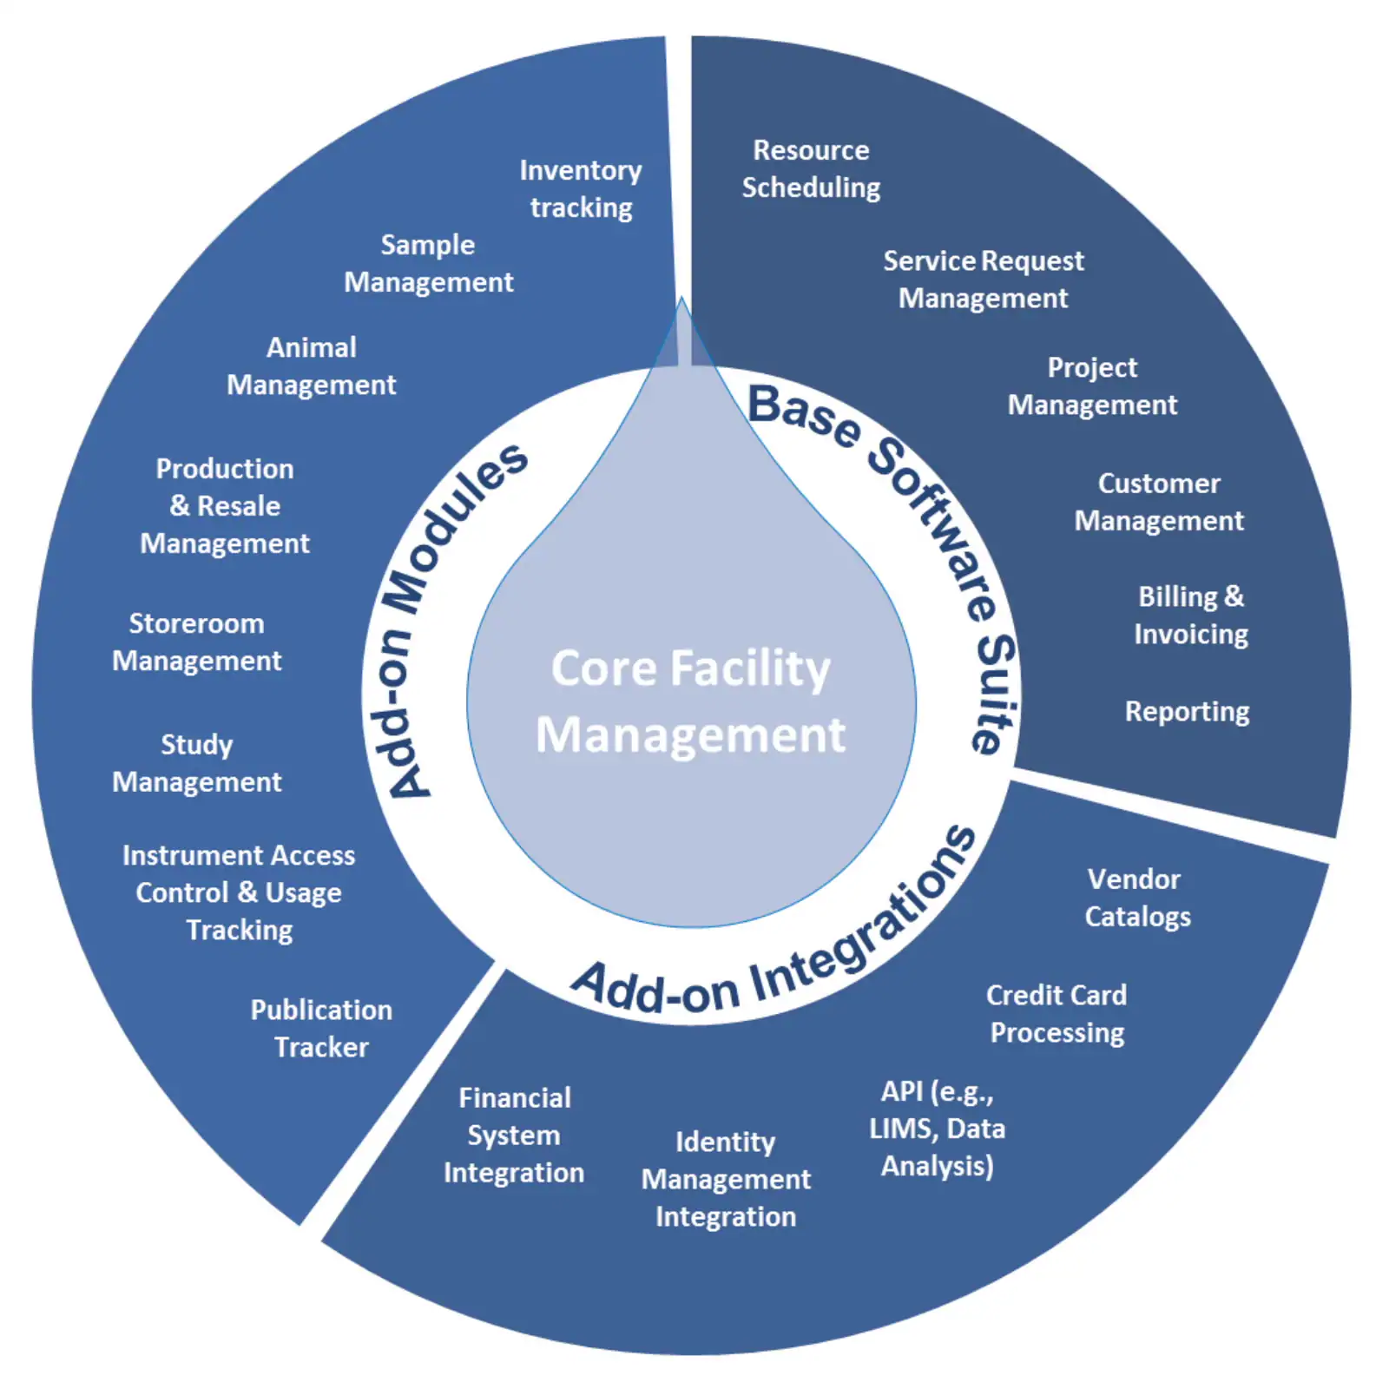
What is iLab?
A tool designed to support labs and shared resource facilities
Uses calendars for booking time with equipment and technical staff
Controls access to sensitive or validated equipment
Manage project requests which track time and billing
Manages on-hand inventory in the facilities

Slide 4
Key terms and concepts

Slide 5

Key terms - entities
Institution: the overall organisation ie Griffith University.
Core Facility: an entity that offers services or access to resources in the university. In iLab, each Facility (Core, for short) has an online store-front that customers can use to identify the offerings available and directly order products/services.
Lab/Group: A group of users, supervised/managed by a Principal Investigator(PI) and/or Lab/Group Managers. In iLab, Labs/Groups are typically used as the primary way to organize access to Funds and manage financial approvals for purchases at Core Facilities.
Centre: A group of labs used to manage subscriptions to GRIDD. If a lab is added to a subscription centre then pricing will be set to zero for all work covered by the subscription.

Slide 6
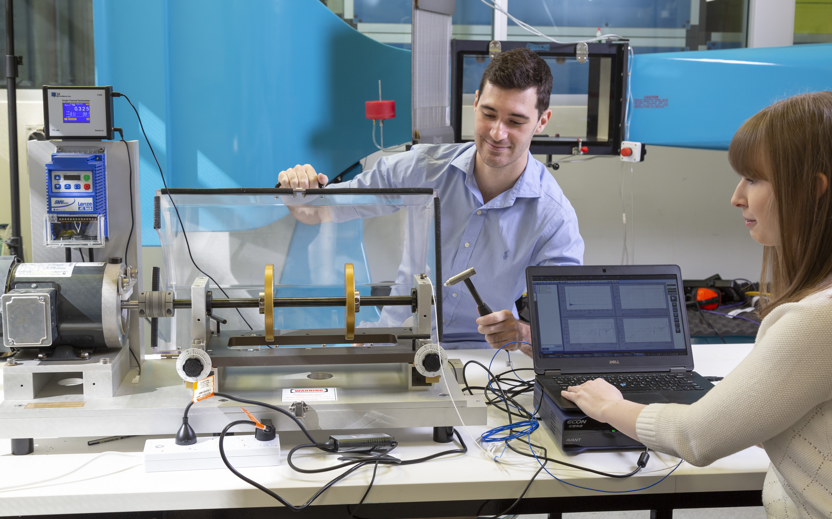
Key terms - users
Institutional Administrator: Dorlene Bradshaw who works in the Office for Research can help with new labs, new accounts and any support issues related to iLab
Principal Investigator (PI): This role is the leader of a lab or group within iLab. Has certain rights to manage users in their lab and control financial access / approvals. (Researcher Leaders)
Lab/Group Manager: Administrator of a lab or group with rights similar to the PI. (Nominated Persons)
Lab/Group Member: Any member of a lab or group that does not have any special administrative rights. This is the role that makes requests and bookings. (Staff)
Core Administrator: Managers of a Facility with administrative permissions. (Ian, Maria, Wendy)
Core Member: Staff at a Facility without the administrative permissions. (Facility Managers)

Slide 7

More key terms
Fund: Speed Type & Class used to source funds from when booking services, equipment and staff. In iLab, Funds are allocated to Labs, and from there assigned to individual Lab members by the PI or Lab Managers. When a user orders from a Facility, or looks to make a reservation, they will be able to choose from the Funds made available to them.
Service request: A customer request for a Core Facility to perform various services.
Charge: An individual "line item" that corresponds to a specific product/service provided by a core.
Resource / Equipment: Something that a Core customer can make a (time-based) reservation against. Often represents a piece of equipment, but can also refer to other resources such as specific facility or time with specialists.
Schedule / Calendar: A collection of the bookings for a specific Resource / Equipment.
Reservation: A claim on a specific time slot on a Schedule / Calendar.
Financial Approval: When services are ordered or resources are reserved, typically a financial approval step needs to be completed before the transaction can be completed. The PI designated as a financial contact will need to provide an explicit approval, unless the amount is below a configurable Approval Threshold (in which case the approval is performed automatically).

Slide 8
Preparing to use iLab

Slide 9
Preparing to use iLab
Before using iLab you need to know a few things:
Do you have an sNumber?
Do you need a new Lab?
Do you have at least one speed type and class?

Slide 10
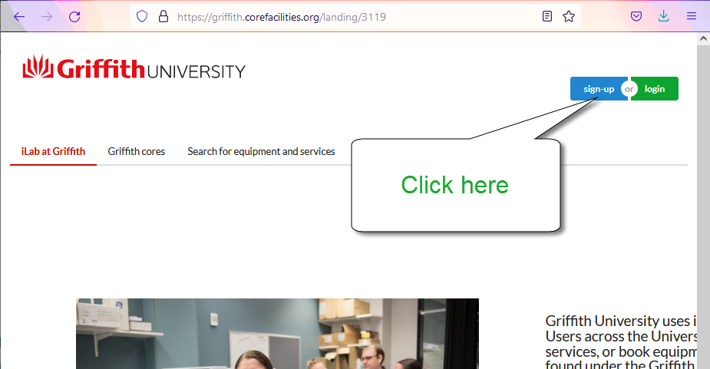
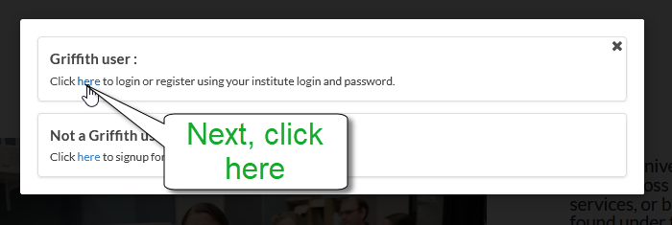
Task Register yourself in iLab
Go to https://griffith.corefacilities.org

Slide 11
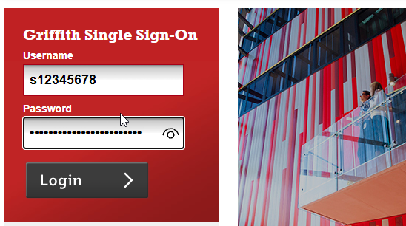
Registration SSO
When the Griffith University Sign on Screen appears, Log in with your sNumber.

Slide 12
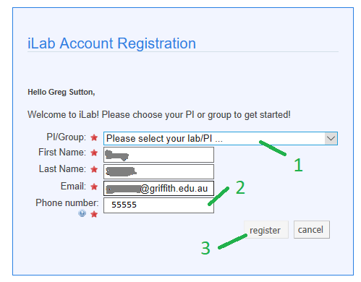

Registration Sign up
Does you research leader already have a lab? Look in the list! If you can’t see them then sign up to the GRIDD Test (Griffith) Lab

Slide 13
Navigation
Using the test login
Finding your way around iLab

Slide 14
The account for today’s training
Today we will be using the following account for our exercises:
Carter Researcher
Login: carter.researcher@ilabx.com
PW: Test1234!

Slide 15
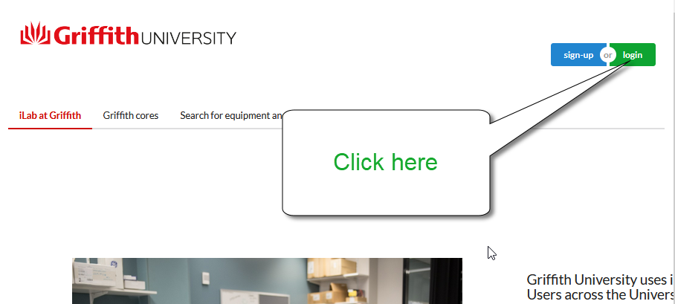
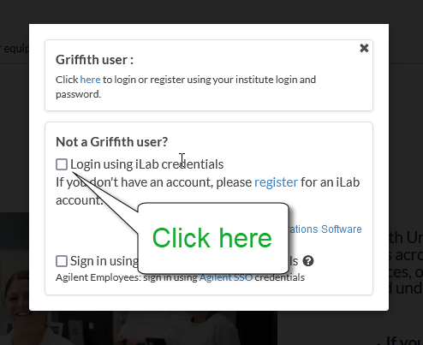
Quick tour Log in to iLab
https://griffith.corefacilities.org/sc/4272/griffith-institute-for-drug-discovery-gridd

Slide 16
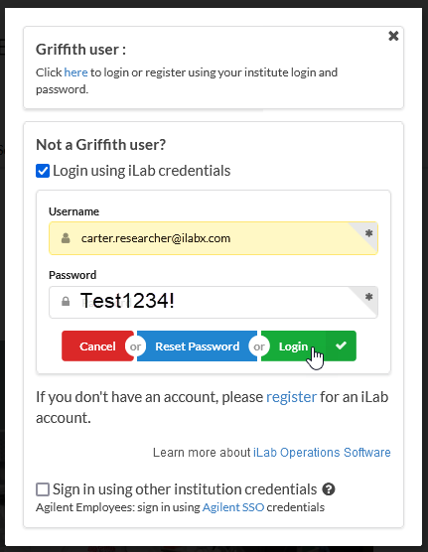
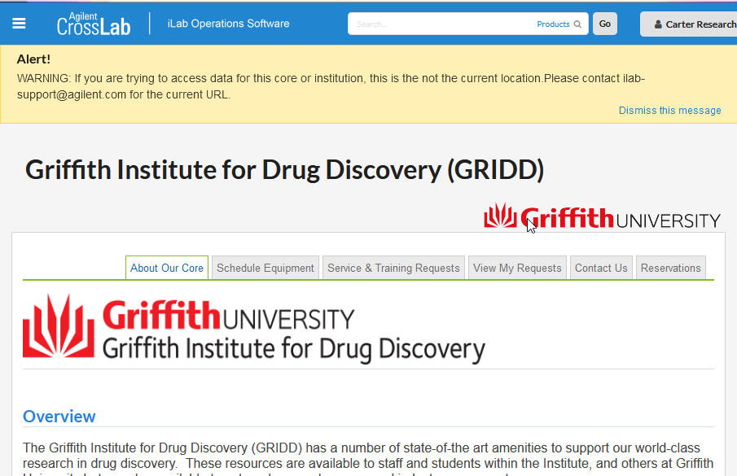
Quick tour Log in to iLab
You should see this

Slide 17
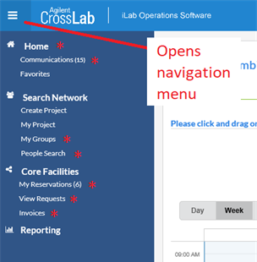
Navigation Hamburger!
Home
Recent facilities (cores)
Unread messages
Service requests with alerts
Communications
My Groups (labs)
My Reservations (bookings)
View Requests (including group members)
Invoices
Notes:
Home:
Recently used cores
Unread messages link
Service Requests (Alerts)
Communications:
Messages that have been sent to you from iLab
My Groups

Slide 18

Core Training

Slide 19
GRIDD iLab Core
Core Overview
Requesting Induction, Training and Services
Requesting Operator Assistance
Making Booking and Reporting issues
Using the Kiosk and QR codes
Getting consumables (NMR)
Managing your requests

Slide 20
Core Overview
Tabs & Navigation inside the core

Slide 21
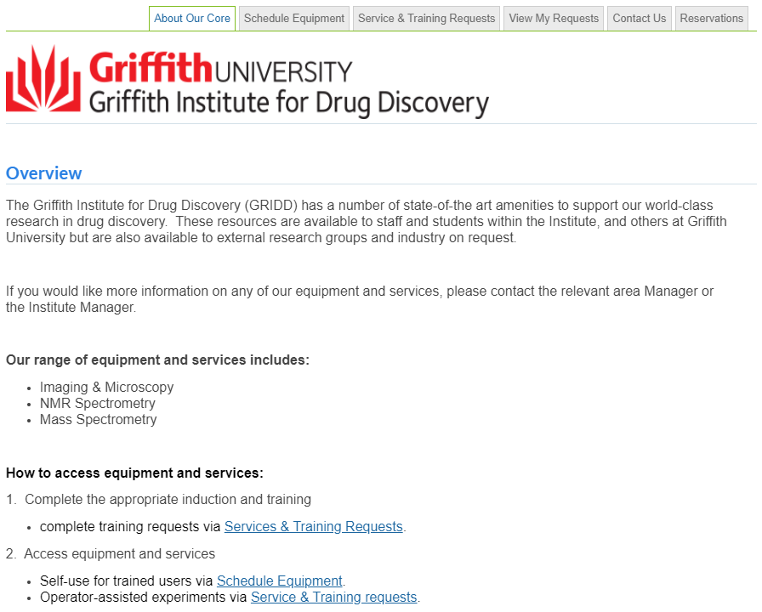
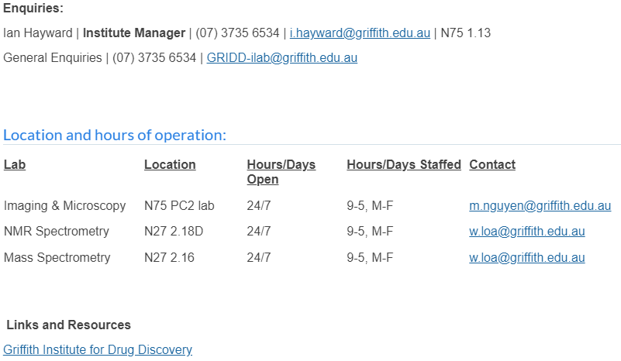
Core Overview
Tabs to navigate iLab

Slide 22
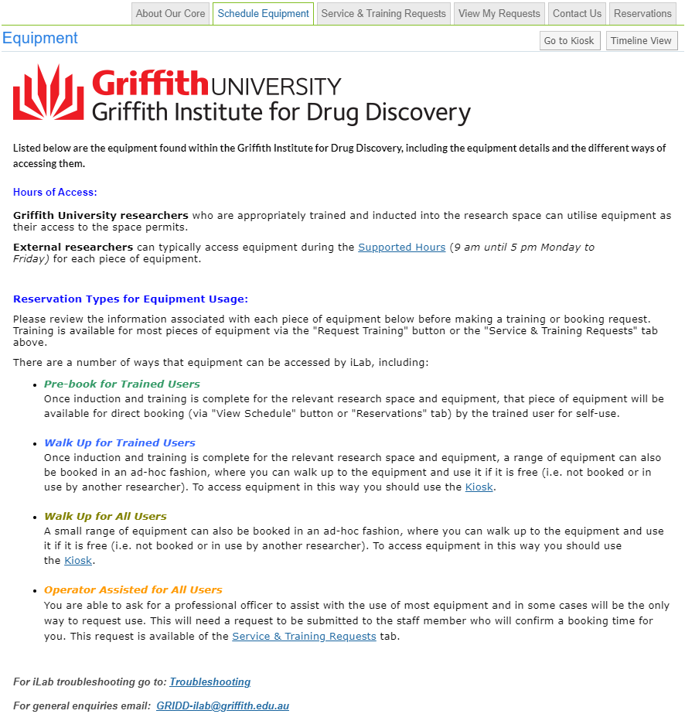
GRIDD Equipment
GRIDD iLab Core is supporting GRIDD Equipment
Over 80 instruments have been on-boarded into the GRIDD core - including:
Analytical Equipment (including NMR, MS, PCR, Plate readers etc)
Imaging Equipment (Microscopes, Molecular Imaging etc)
Others (Liquid handlers, Centrifuges, FPLC, HPLC, large shakers etc)
Booking equipment will be exclusively through iLab
Pre-book for Trained Users
Walk Up for Trained Users
Walk Up for All Users
Operator Assisted for All Users
Notes:
Over 80 instruments onboard, more to follow.

Slide 23
Requesting Induction, Training & Services

Slide 24
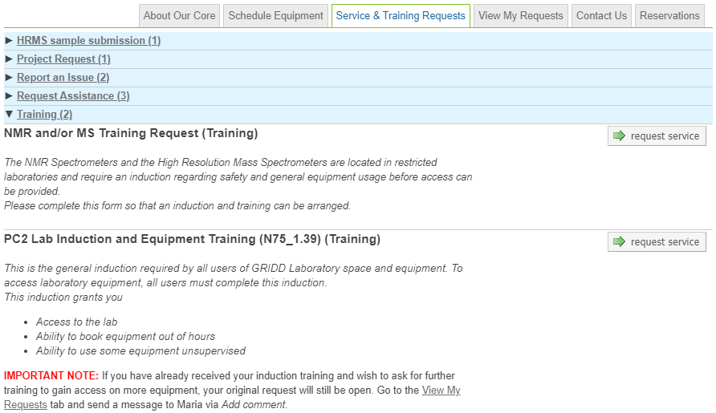
Requesting an Induction and Training
For new users!
Existing users, when setting up iLab, we will already note your access and permissions.

Slide 25
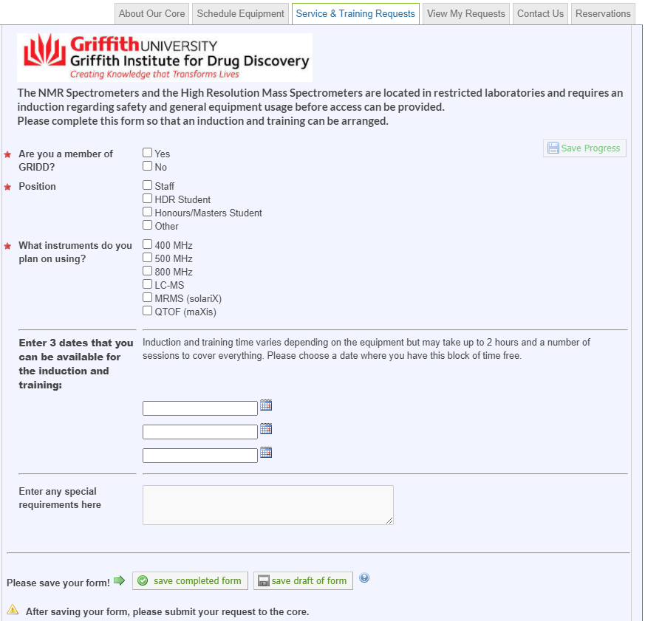
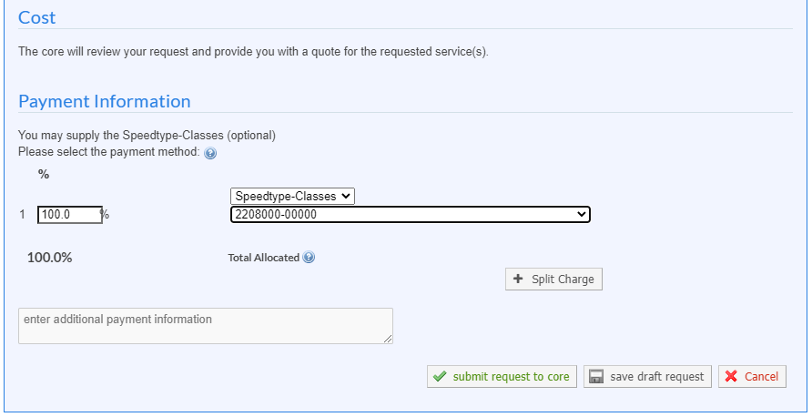
NMR & Mass Spec
Complete all form fields
Save form & submit request

Slide 26
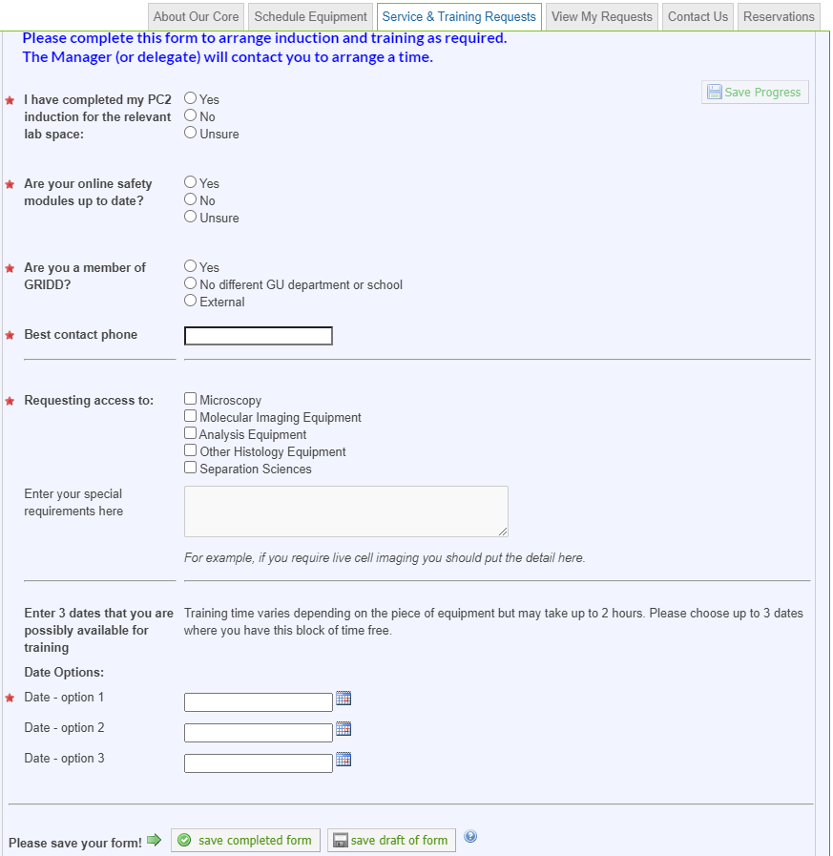
PC2
Complete all form fields
Save form & submit request

Slide 27
Requesting Operator Assisted Services

Slide 28
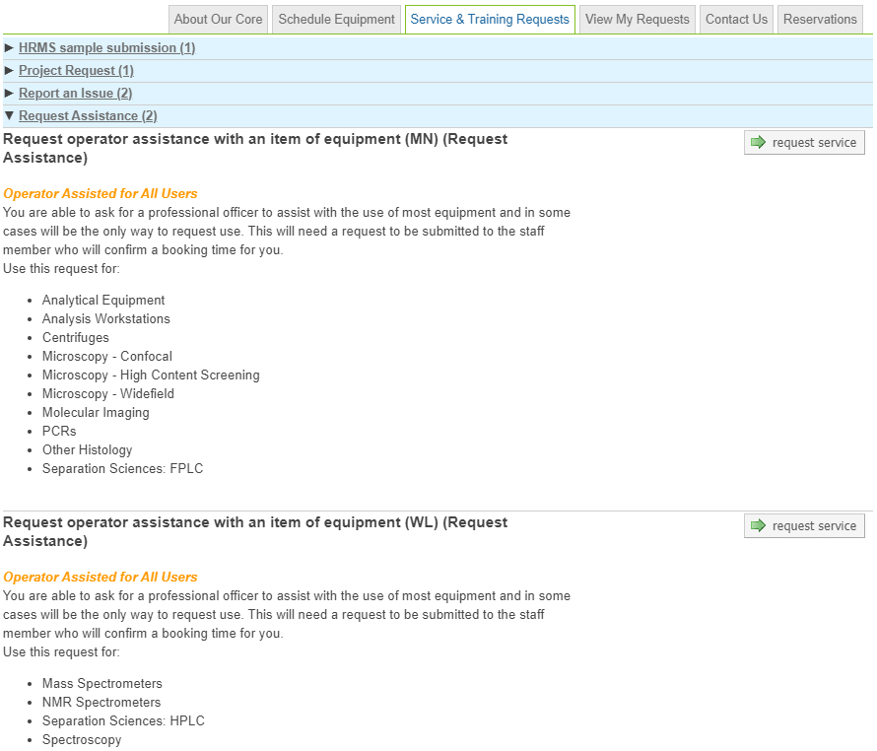
Requesting Assistance with Equipment
Additional/specialised training
Additional assistance
Non routine experiments/ experiment set up
Experiment run by facility manager

Slide 29
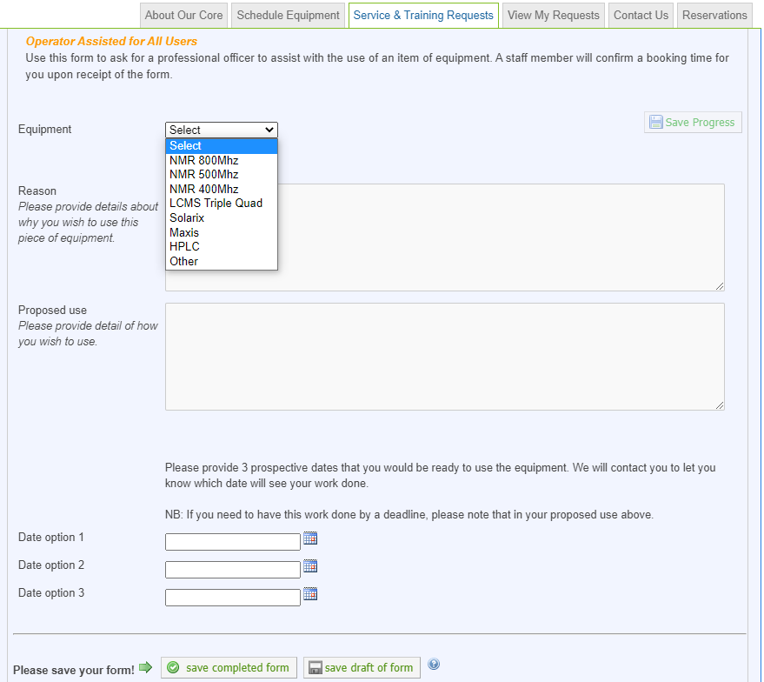
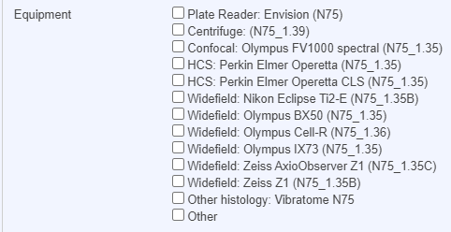
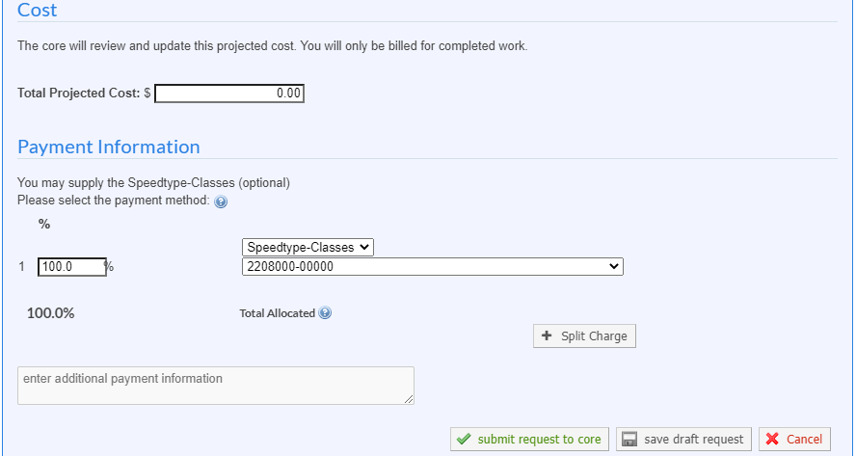
For NMR & Mass Spec
For PC2
Select equipment required
Save form & submit request

Slide 30
Making Bookings and reporting issues

Slide 31
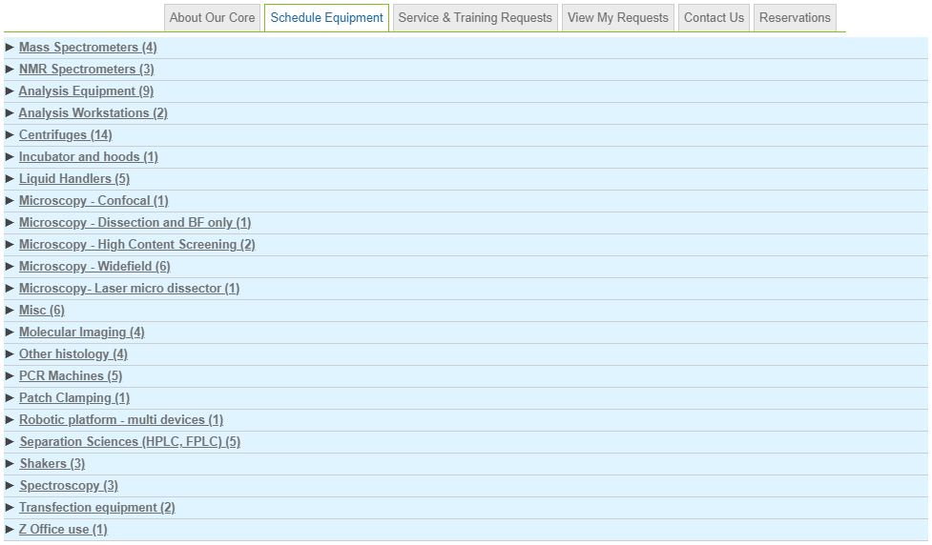
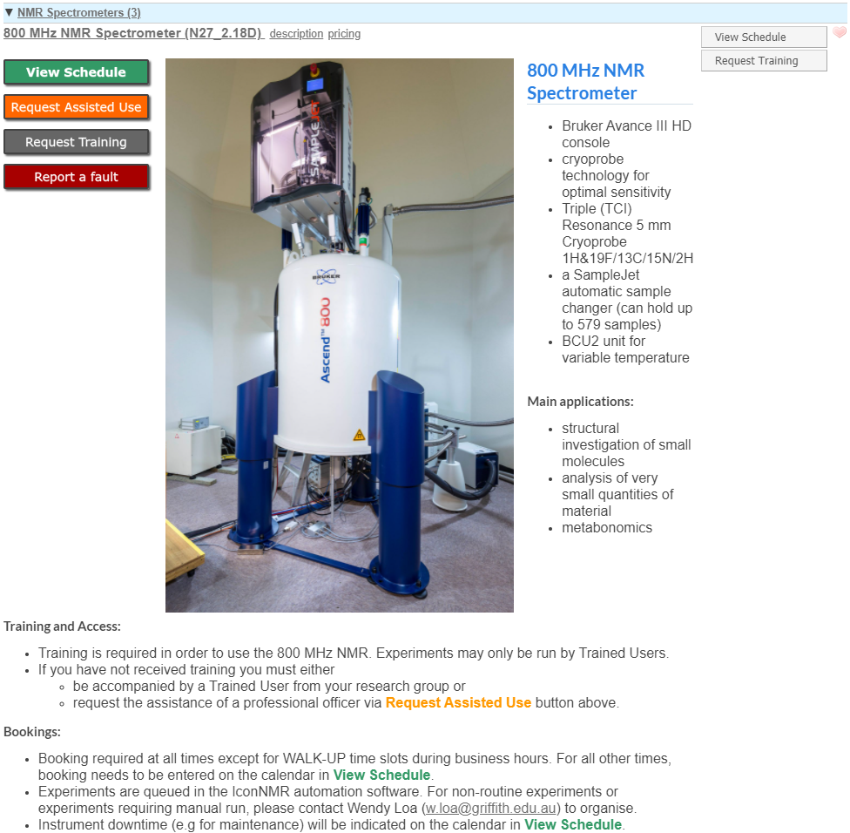

Pre-booking for Trained Users via View Schedule
Notes:
Mention the Request Assisted Use button.

Slide 32
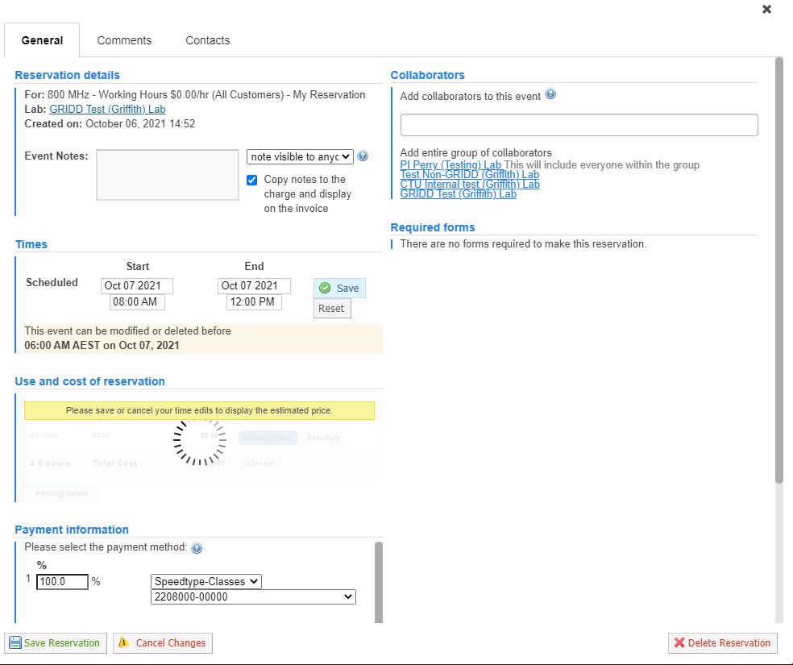
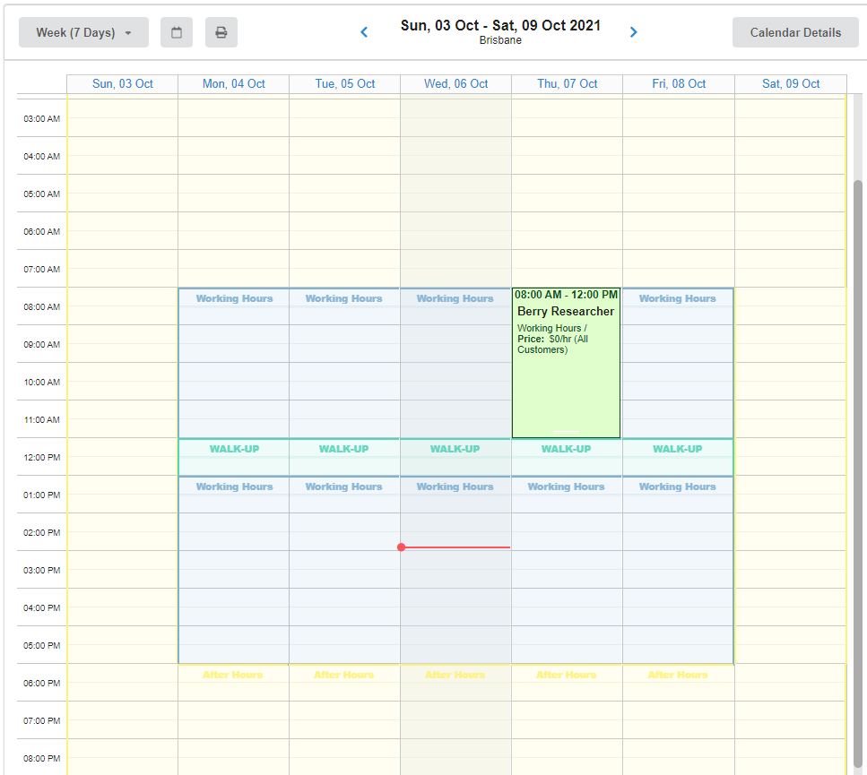
Pre-booking for Trained Users via View Schedule
Check availability of equipment
Check your reservation

Slide 33
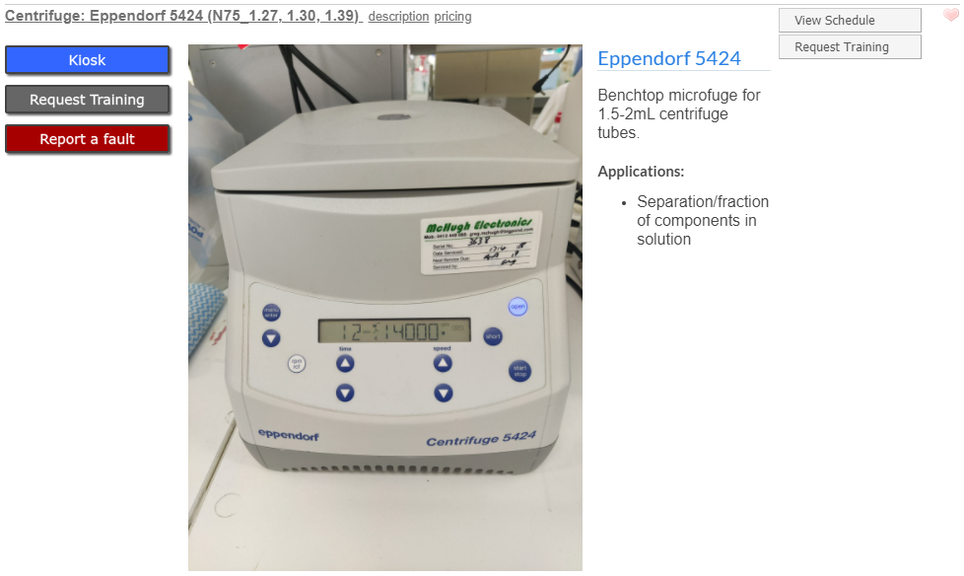
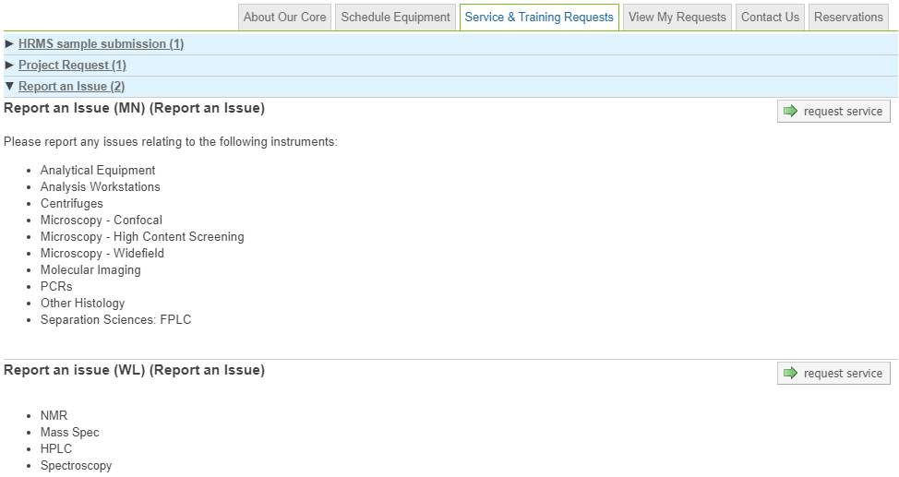
Reporting an issue
Click on Report a fault
Fill in the form, Save and Submit
or Report an Issue

Slide 34
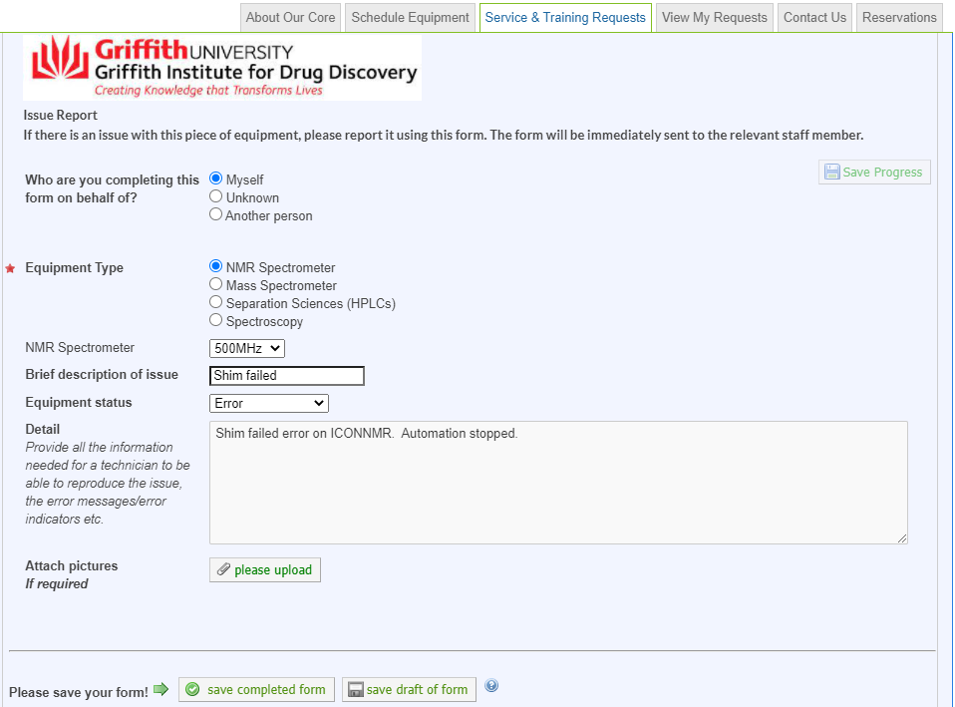
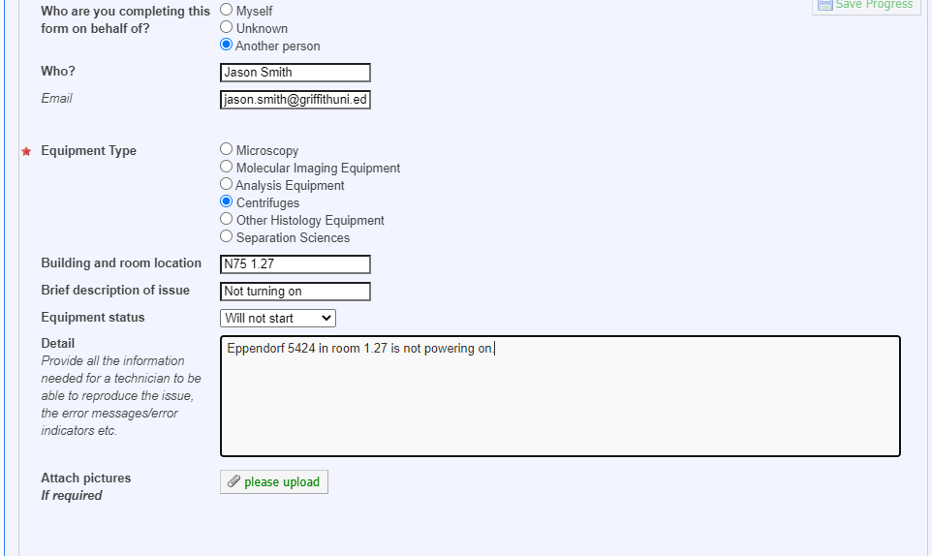
Reporting an issue
Complete all form fields
Save and Submit

Slide 35
Exercise Carter Researcher
Book a time slot on:
the 800 MHz NMR
or
the Eppendorf 5424 centrifuge

Slide 36
Kiosk and QR codes

Slide 37
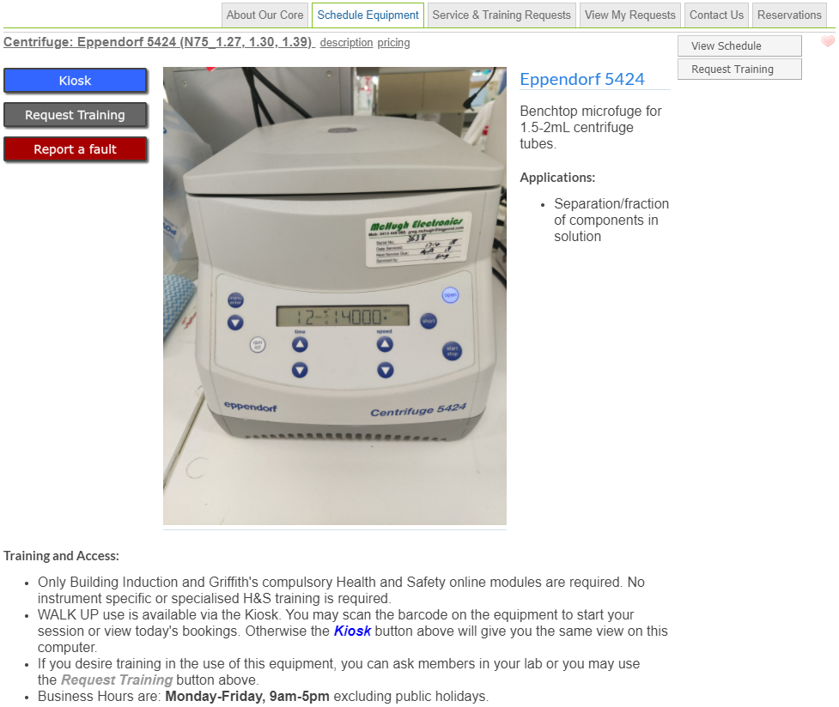
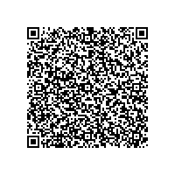
Kiosk and QR codes
Recording usage
Click on Kiosk or
Scan QR code on equipment
Try me!

Slide 38
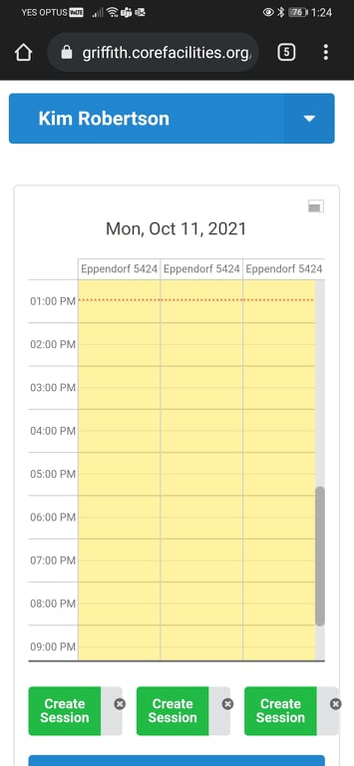
Exercise Use the Kiosk on your phone
Try using this QR Code on your phone.
First time in the day iLab will make
You authenticate.
Once you have signed in, try it again to get straight to the instrument!
Try me!

Slide 39
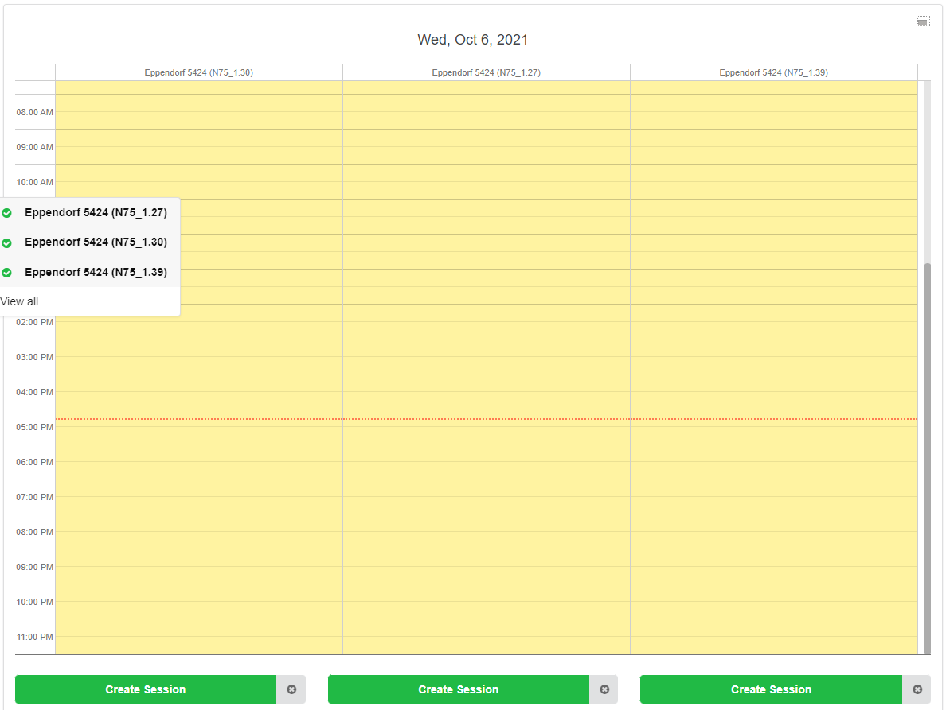
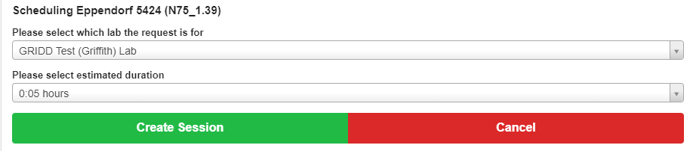
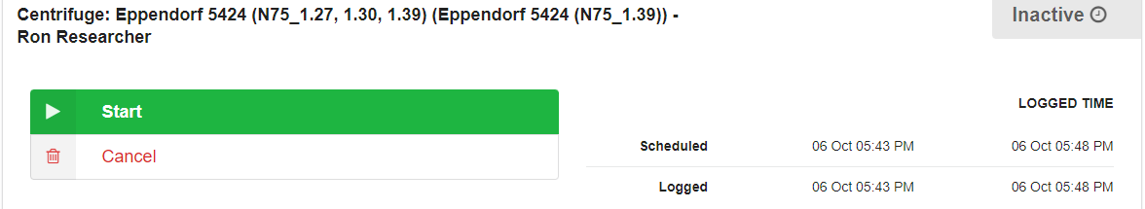
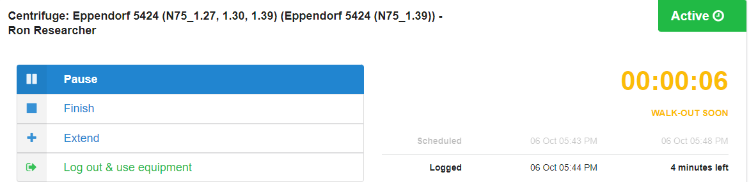
Kiosk and QR codes
Select equipment
Create Session
Start session
Finish within duration of walk-up or
Extend

Slide 40
Ordering
Consumables

Slide 41
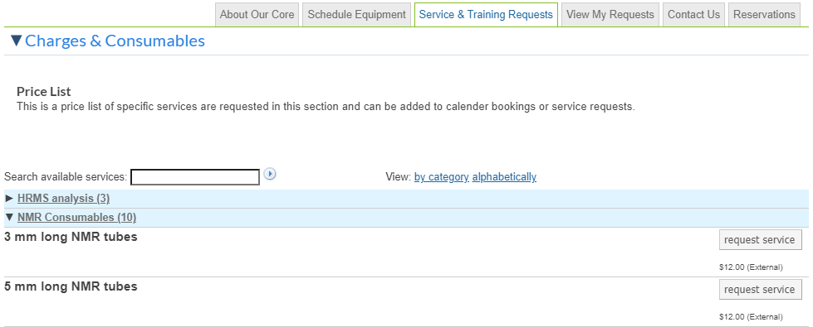
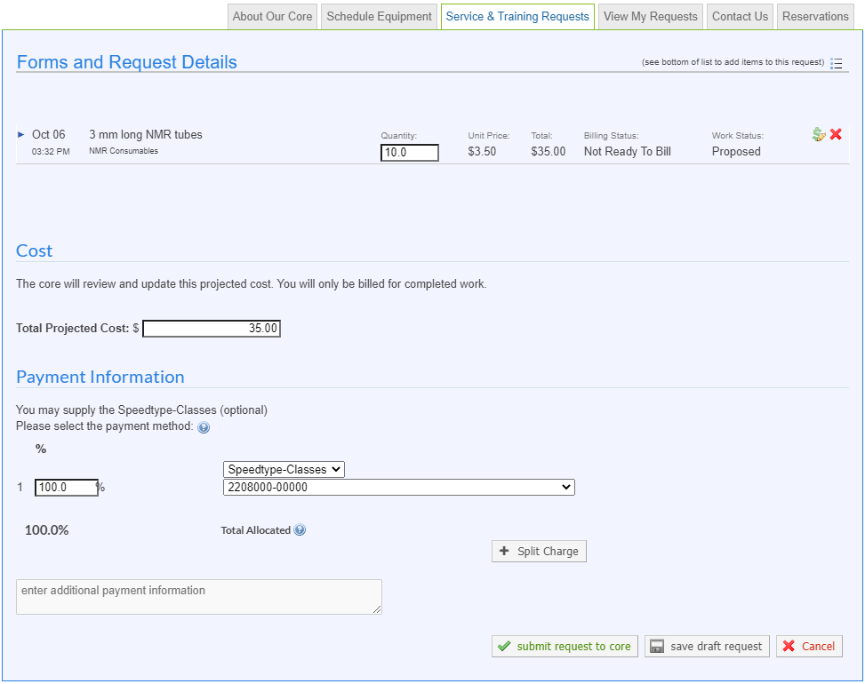
Ordering consumables (NMR)
Once you have submitted the form, you can pick up your consumable as per normal

Slide 42
Managing Your Requests

Slide 43
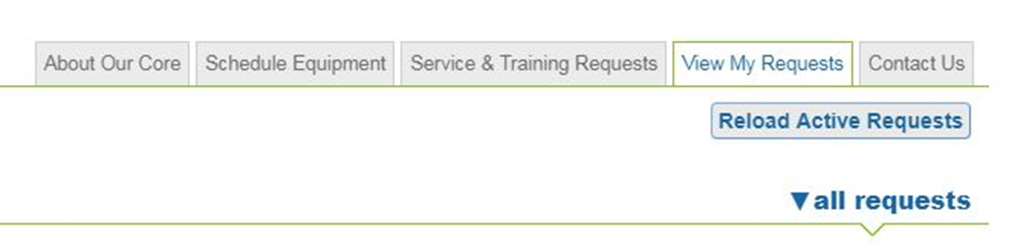
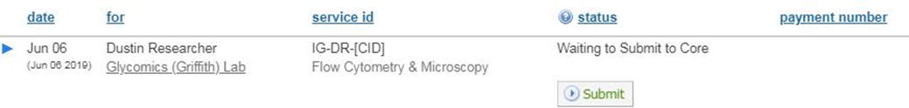
View My Requests
Once submitted to core, View My Requests tab will appear.
Check status of request:
Submit to core

Slide 44
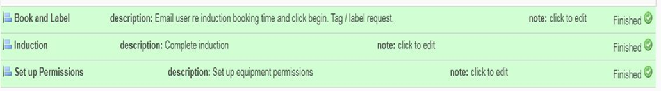
View My Requests
The core will review the request and contact the person regarding induction time.
Each requestor can check status of request.
Book and Label
Induction time booked in
Induction
Induction complete
Set up Permission
Access level granted to enable booking via Schedule Equipment tab

Slide 45
Transition to iLab

Slide 46
Transition
GIBS / Outlook (current systems)
Calendars active until 5th Nov. No more bookings after this date.
iLab
Go Live 25 October 2021.
From 25 Oct onwards advanced bookings can be made for equipment
Cost recovery from within iLab.
Current users will be provided access in the system (re-induction is not required).

Slide 47

Questions and Queries
Contact relevant Facility Manager
Details on About our Core tab
Contact the Institute Manager at i.hayward@griffith.edu.au or Address general enquiries to GRIDD-ilab@griffith.edu.au
Check status of requests
View My Requests

Slide 48
Help & Support

Slide 49
How to get help & training material
Help
Visit web iLab web sites for guides, FAQ’s and more
Ask your facility staff
Request labs, accounts etc to be created from Dorlene Bradshaw
Click on the Help button in iLab – Don’t submit tickets.
Training
Visit iLab web sites
Ask GRIDD staff for training

Slide 50
Reseacher Leader/Principle Investigator Part 1 - Managing your group (Lab)

Slide 51

Managing your lab
In this section we will be looking at how you can manage your lab and set rules for spending money in iLab. This section will be hands on so be ready to use your computer!
Topics:
Roles
Membership
Spending rules

Slide 52
Exercise Carter Researcher
Log into iLab using Carter Researcher

Slide 53
The account for today’s training
Today we will be using the following account for our exercises:
Carter Researcher
Login: carter.researcher@ilabx.com
PW: Test1234!

Slide 54
Quick tour Labs
https://griffith.corefacilities.org/sc/4272/griffith-institute-for-drug-discovery-gridd

Slide 55
Quick tour Labs
You should see this

Slide 56
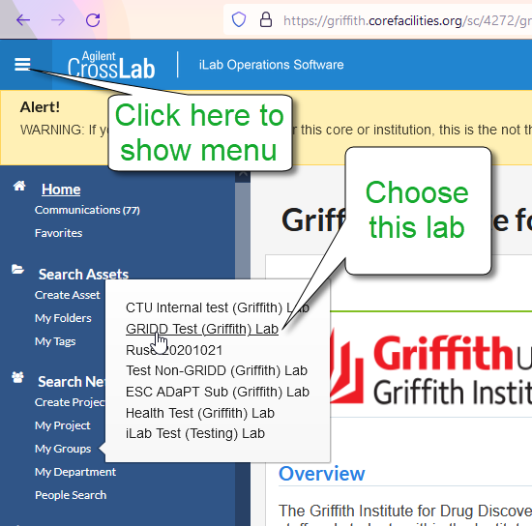
Quick tour Labs

Slide 57
Roles | Managing membership | Managing spending
PI Manager Member | Add new users Add existing users Remove users Accept or reject membership requests Start and end dates | Speedtype and classes Request new Speedtypes and classes are added to your lab Add/remove access to Speedtypes and classes to your lab members Discontinue use of a Speedtype and class Managing approvals and budgets Default auto-approval threshold (everyone) Auto approval amount (individuals) Cost overage buffer Budgets

Slide 58
Reseacher Leader/Principle Investigator Part 2 – Managing requests and reservations

Slide 59

As a PI what can I do?
There are 3 tools available for you to monitor your work and team:
1. Use iLab to reserve equipment etc
Same as your lab members
(see Core Training above)
2. View and approve your team’s requests
3. Report on spending at all of your labs

Slide 60
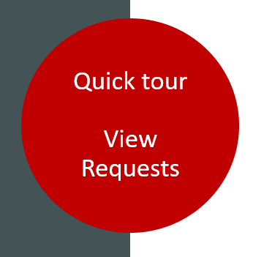
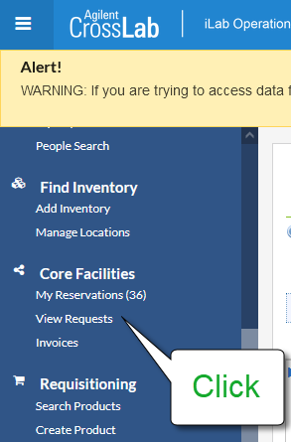
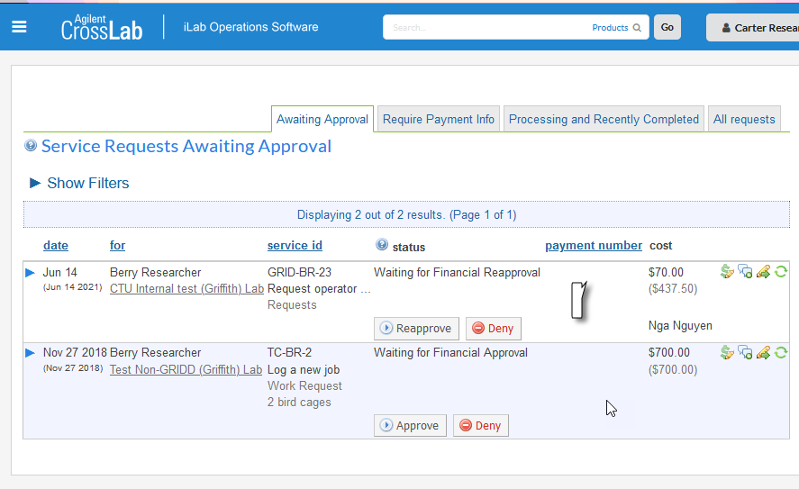
View and Approve Requests

Slide 61
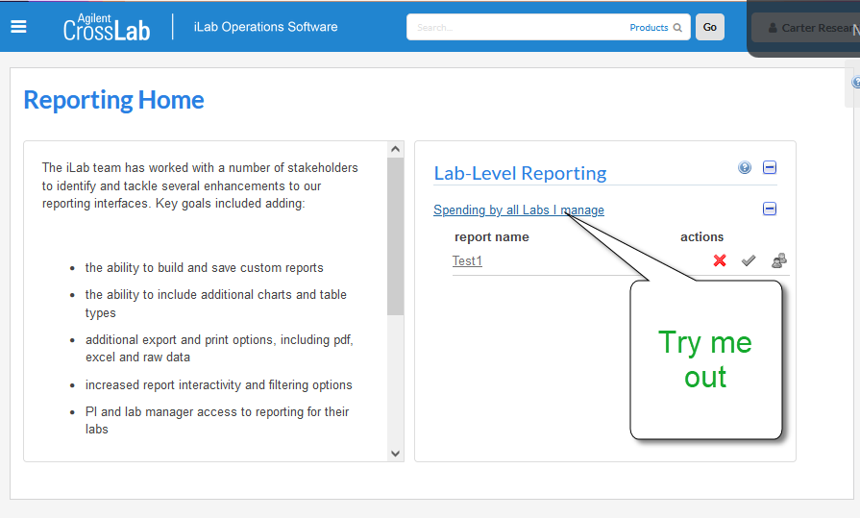

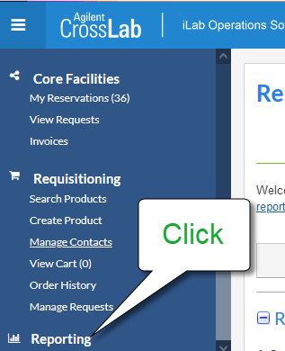
Reports

Slide 62
Help & Support

Slide 63
How to get help & training material
Help
Visit web iLab web sites for guides, FAQ’s and more
Ask your facility staff
Request labs, accounts etc to be created from Dorlene Bradshaw
Click on the Help button in iLab – Don’t submit tickets.
Training
Visit iLab web sites
Ask GRIDD staff for training

